Slide 1
Theatre
in
Germany

Slide 2
history
First theatres were in the Stone Age
But the development of the theatre began only properly in Greece
The theatre was developed in every time epoch
At that time there was theatre only in that form from operas and classical concerts
Today it exists in many different forms

Slide 3
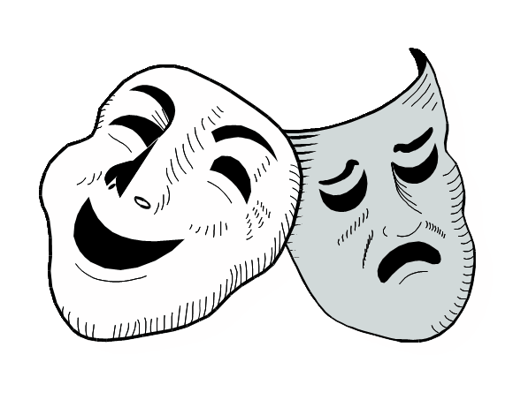
importance of theatre
Is a part of the culture of the world
shows an insight of different time epochs
offers a variety of entertainment

Slide 4
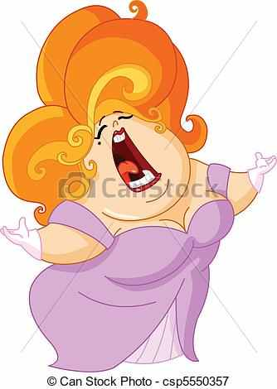
theatre species
language theatre
music theatre
dance theatre
figure theatre
musicals
opera/operette
ballet
children theatre
criminal theatre

Slide 5
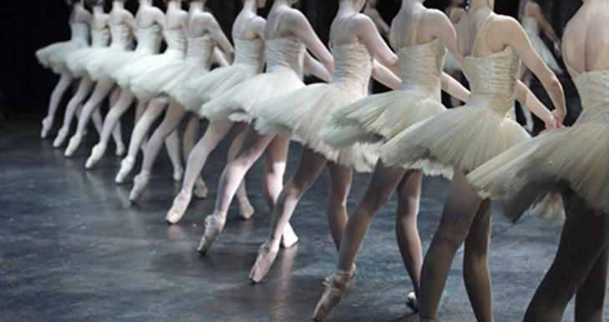
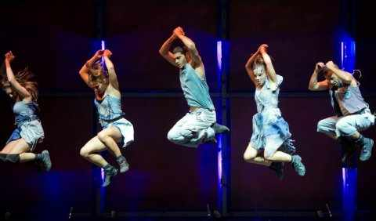
dance theatre
Schwanensee
modern dance

Slide 6
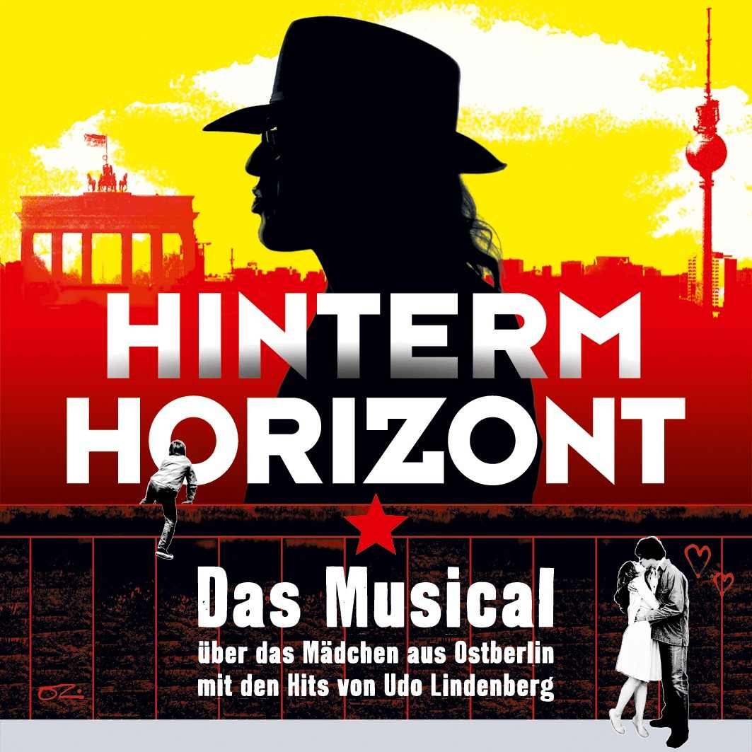
In Germany there are a lot of musicals.
for example:

Slide 7
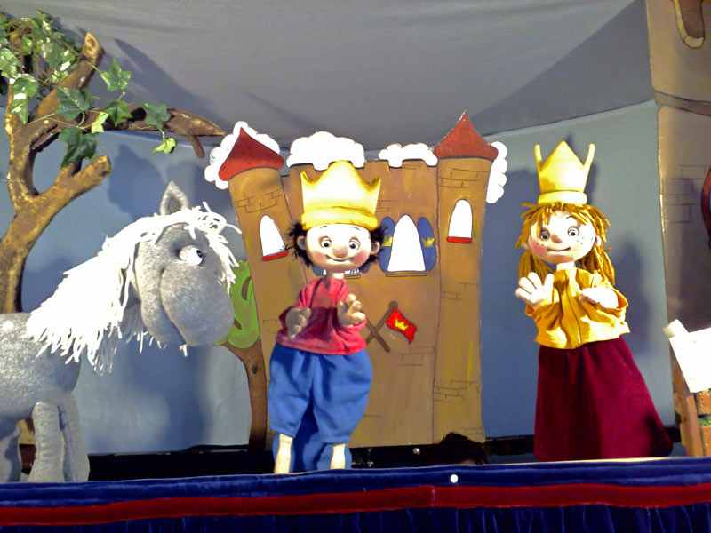
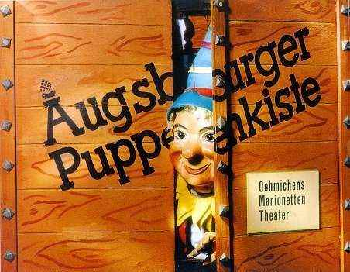
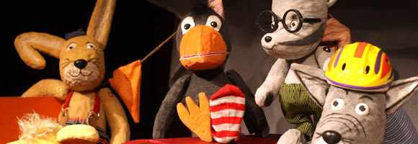
Theatre for young and old
The little king
Die Augsburger
Puppenkiste
The little raven Socke

Slide 8
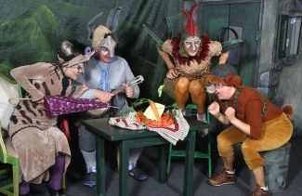
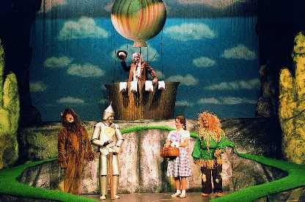
Theatre for children
Die Bremer Stadtmusikanten
Town Musicians of Bremen
Der Zauberer von Oz
The Wizard of Oz

Slide 9
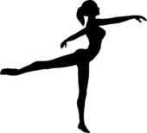
theatre serves the entertainment of the people
people use this art as a leisure time activity
the importance of theatre in Germany is not higher or lower as in other parts of the world
is not decided by the country, but it is by the education and the direct environment of a human

Slide 10
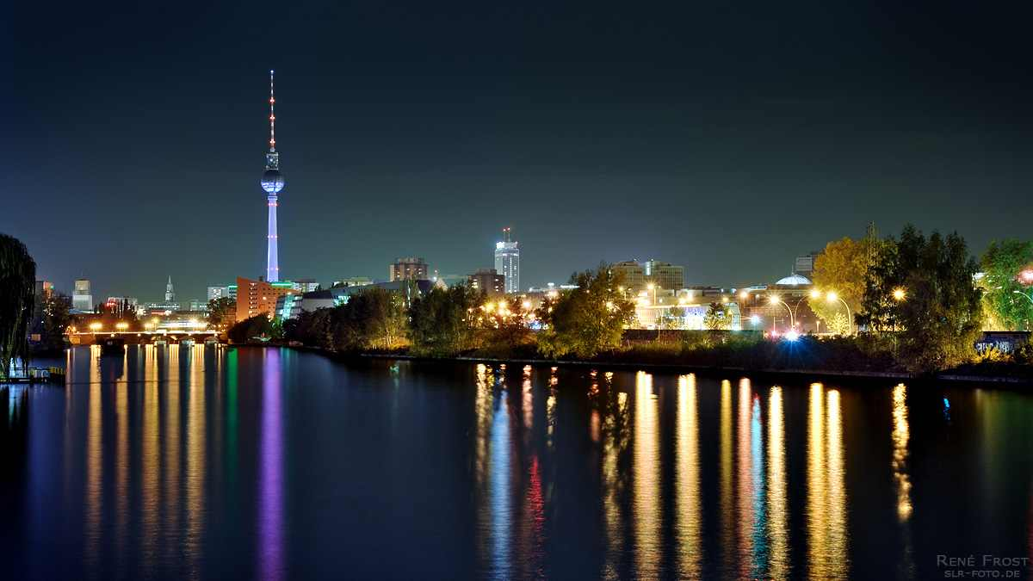
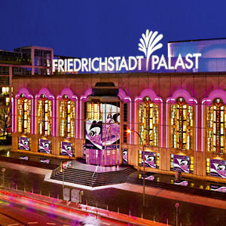
The biggest theatre is in Berlin: “Friedrichstadt Palast” → also suitable for international guests!

Slide 12
The most important theatres of Berlin
Berliner Ensemble
Theater des Westens
Deutsches Theater
Komische Oper
Maxim-Gorki-Theater
Schillertheater
Theater am Kurfürstendamm

Slide 13
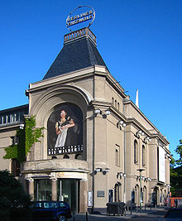
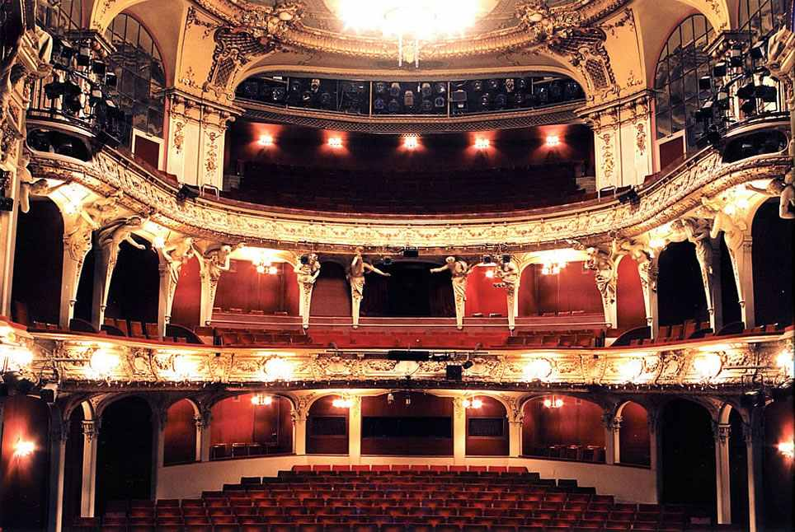
Berliner Ensemble
The Berliner ensemble shows one of the best known stages of the German capital.

Slide 14
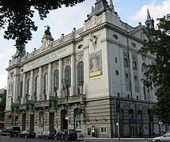
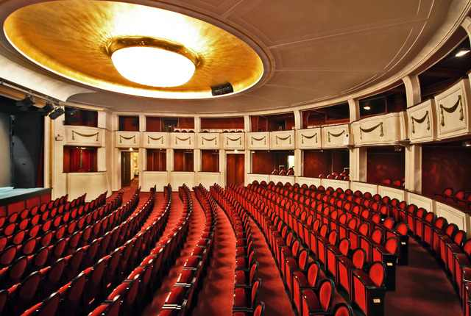
Theater des Westens
(Theatre of the West)
It´s one of the most famous theatres for musicals and operettas in Berlin.

Slide 15
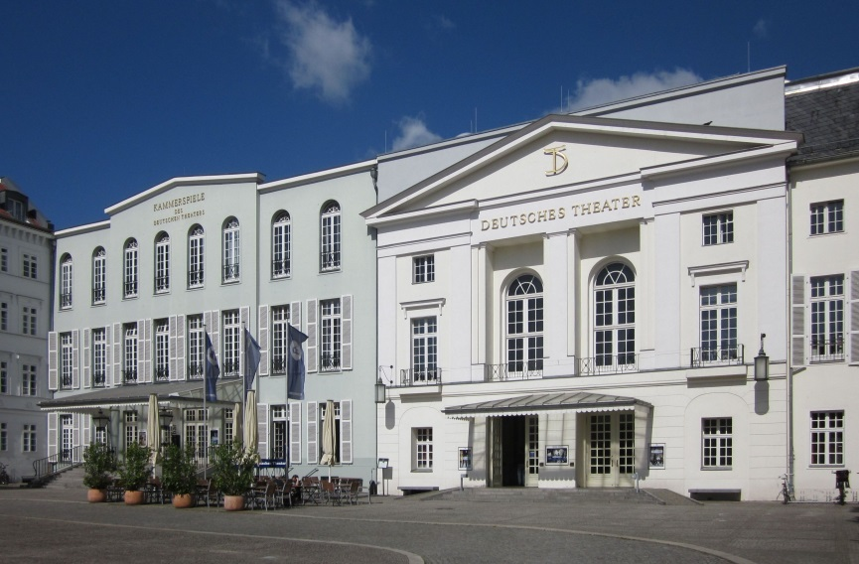
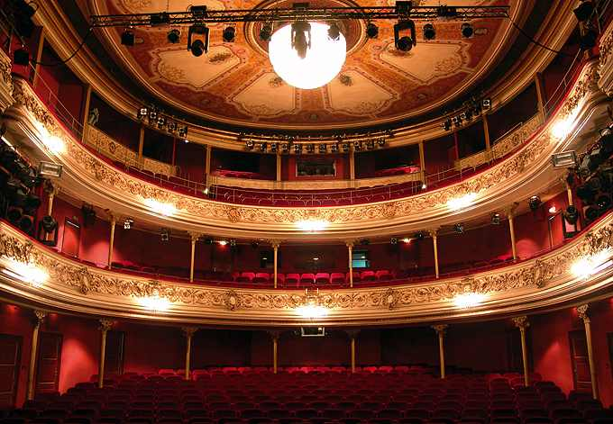
Deutsches Theater
The Deutsches
Theater consists of
two adjoining
stages that share a
common, classical
facade.
The main
stage was built in
1850, originally for
operettas.

Slide 16
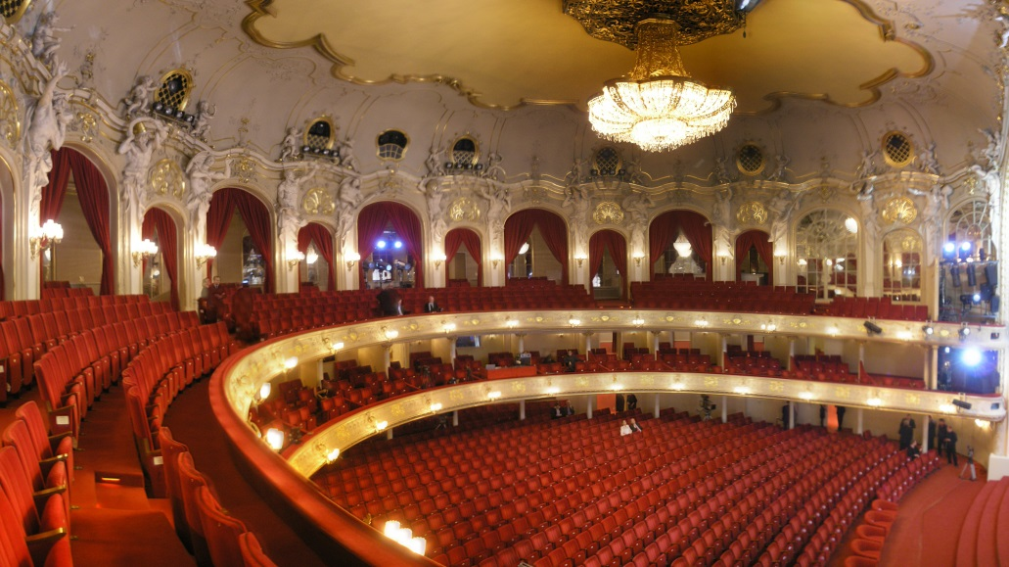
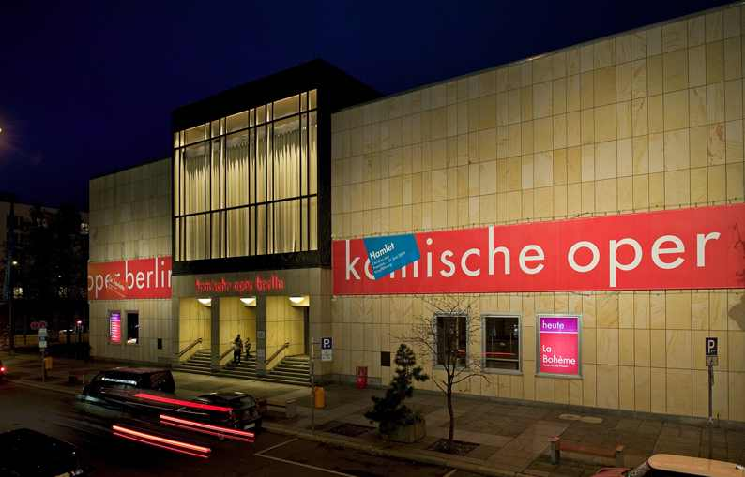
Komische Oper
is an opera
company in
Berlin which
specializes in
German
language
productions
of opera, operetta and musicals.

Slide 17
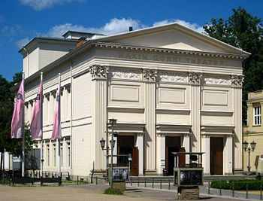
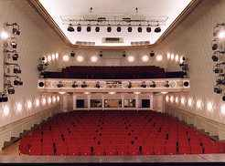
Maxim-Gorki-Theater
is the smallest in Berlin
it has 440 seats

Slide 18
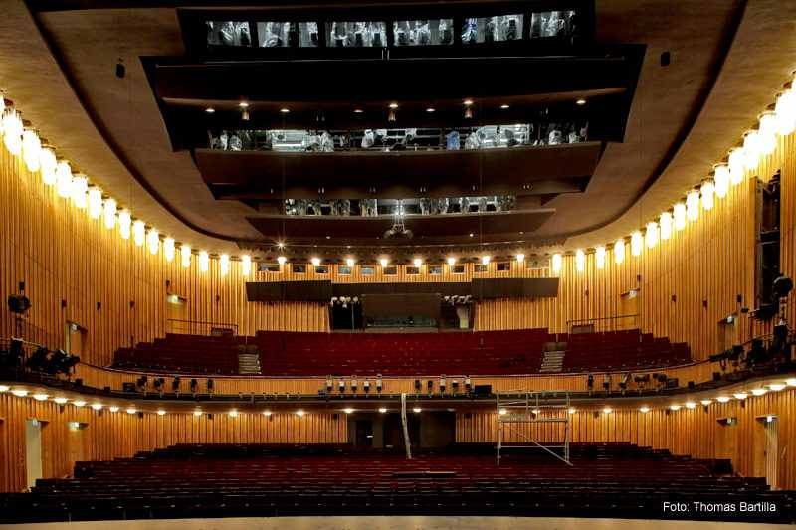
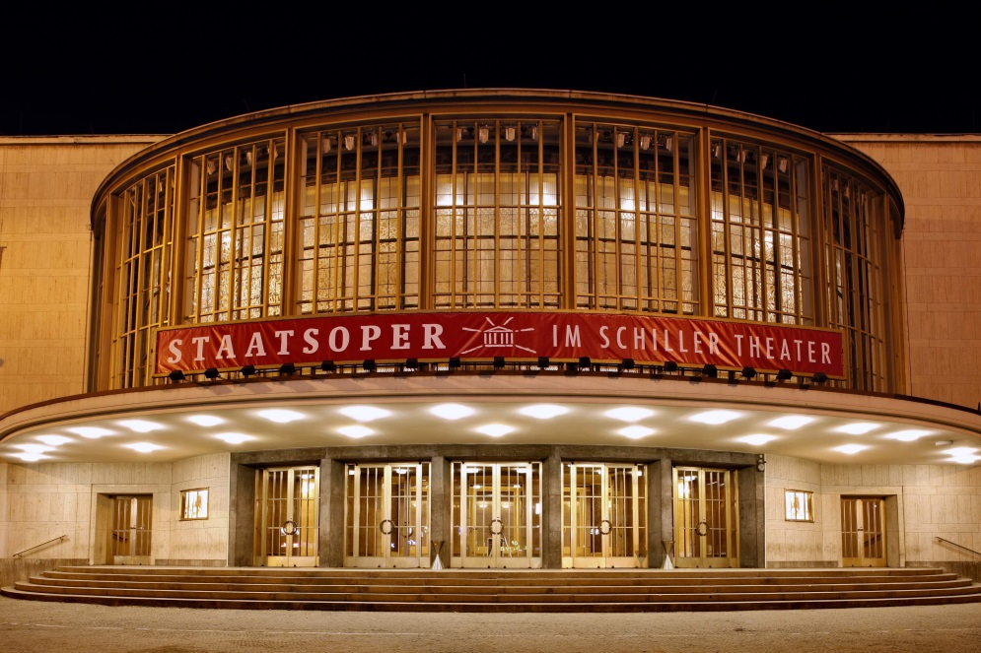
Schillertheater

Slide 19
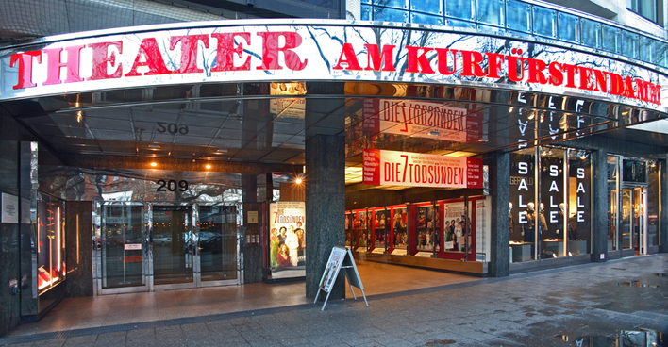
Theater am Kurfürstendamm
it is one of the most famous private theatres in Berlin
it is located on the famous Kurfürstendamm, shopping and cultural street

Slide 20
Famous theatre people
Gotthold Ephraim Lessing
Friedrich Schiller
Johann Sebastian Goethe
Heinrich Heine
Bertholt Brecht

Slide 21
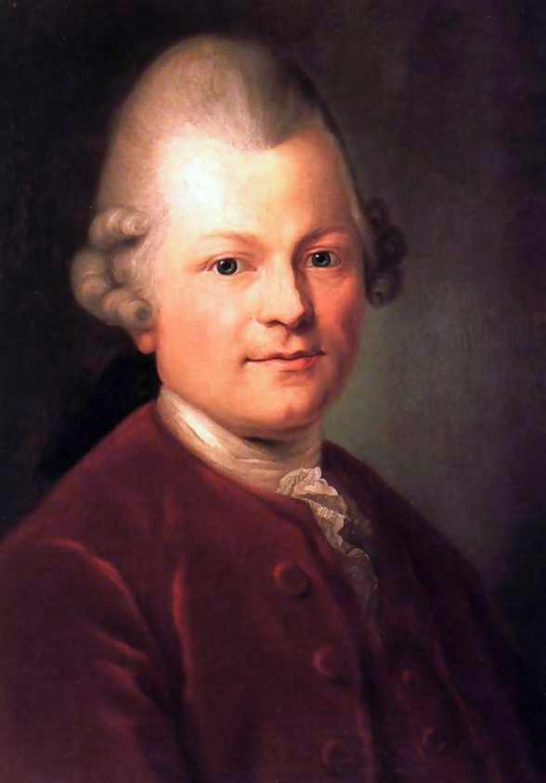
Gotthold Ephraim Lessing
was a German writer, philosopher, dramatist, publicist
and art critic,
his plays and theoretical writings substantially influenced the development of German literature
he is widely considered by theatre historians to be the first dramaturg

Slide 22
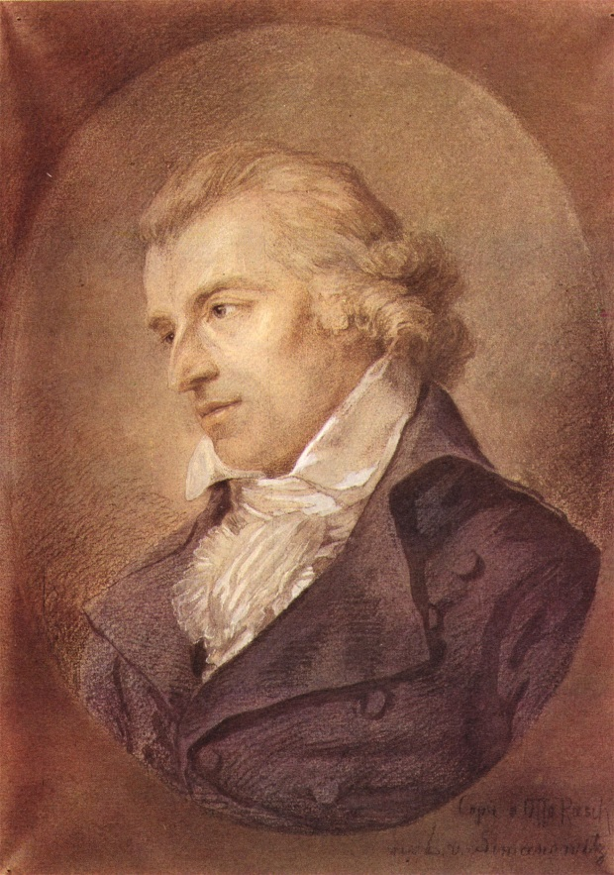
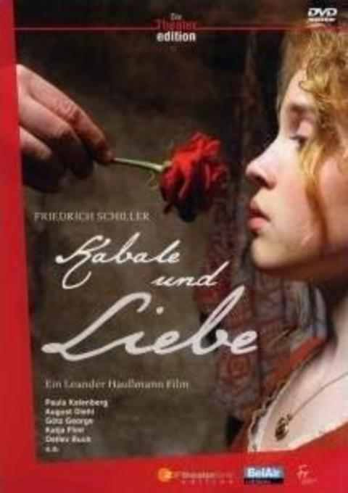
Friedrich Schiller
He was a German poet,
philosopher, historian
Many works are part of the standard repertoire of German theatre

Slide 23
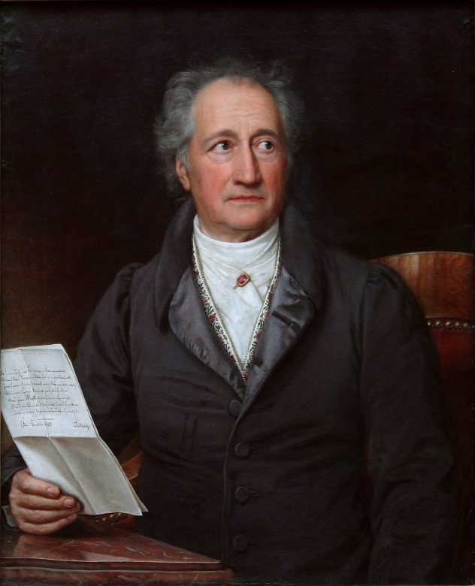
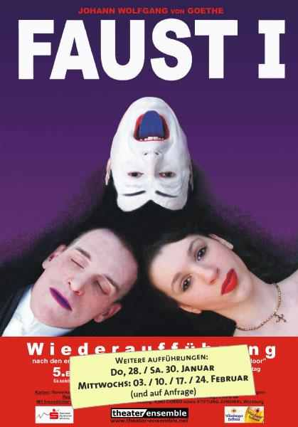
Johann-Wolfgang von Geothe
His famous
theatre piece is
Faust part one
and part two.
He was a writer
and poet.

Slide 24
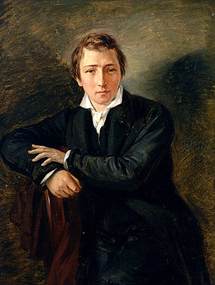
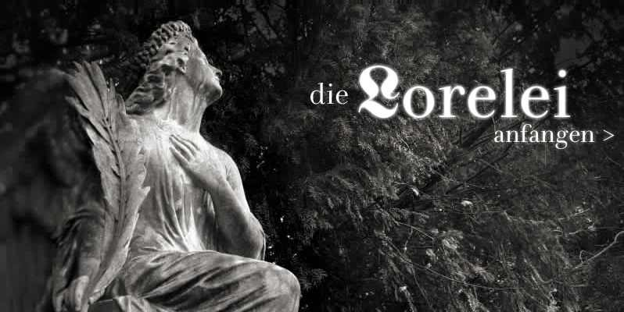
Heinrich Heine
He was one of the most significant German poets of the 19th century.
He was also a journalist, essayist, and literary critic.

Slide 25
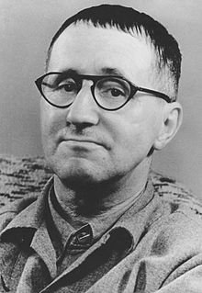
Bertolt Brecht 1898 –1956
Bertolt Brecht is one of the most
famous people of the theatre
world.
His works are performed worldwide.

