Slide 1
The Finow Canal
Streets connect people

Slide 2
Contents
1. The Finow Canal in the past
2. The Finow Canal today
3. The locks along the Canal
4. Solarboat project at the Canal

Slide 3
Contents
1. The Finow Canal in the past
2. The Finow Canal today
3. The locks along the Canal
4. Solarboat project at the Canal

Slide 4
1. The Finow Canal in the past
the Finow Canal was built from 1603 to 1620
the waterway connects the rivers Havel and Oder
it is Germanys oldest navigable canal
in the 18th century it was basis for an economic boom
different industrial plants were built
around 1900 2.6 million tons of goods were shipped

Slide 5
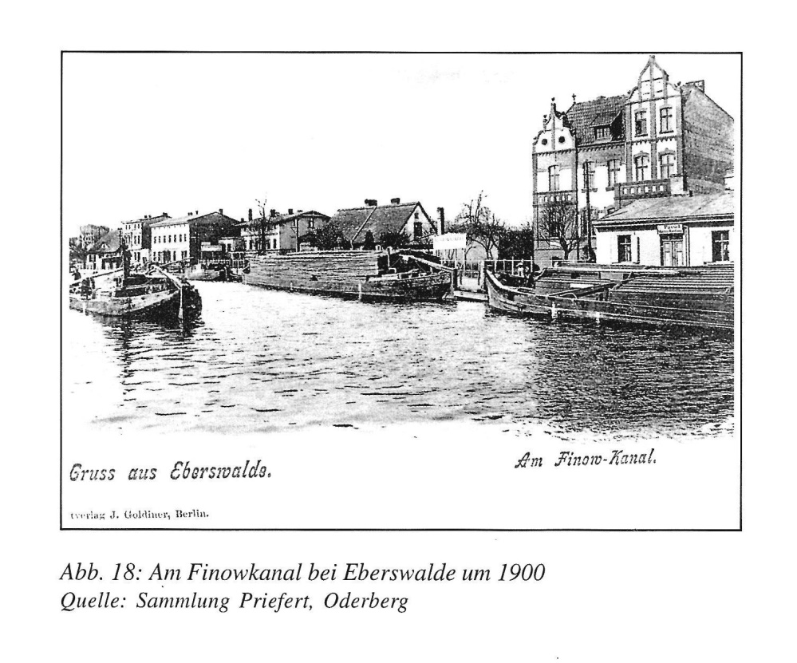
1. The Finow Canal in the past
The Finow Canal in Eberswalde around 1900
Quelle: Sammlung Priefert, Oderberg

Slide 6
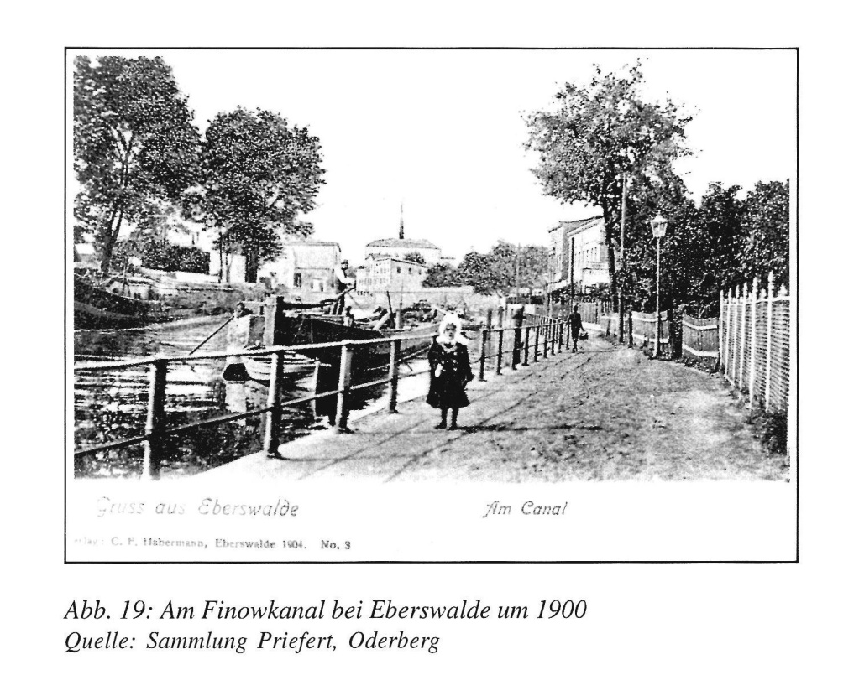
1. The Finow Canal in the past
At the Finow Canal in Eberswalde around 1900
Quelle: Sammlung Priefert, Oderberg

Slide 7
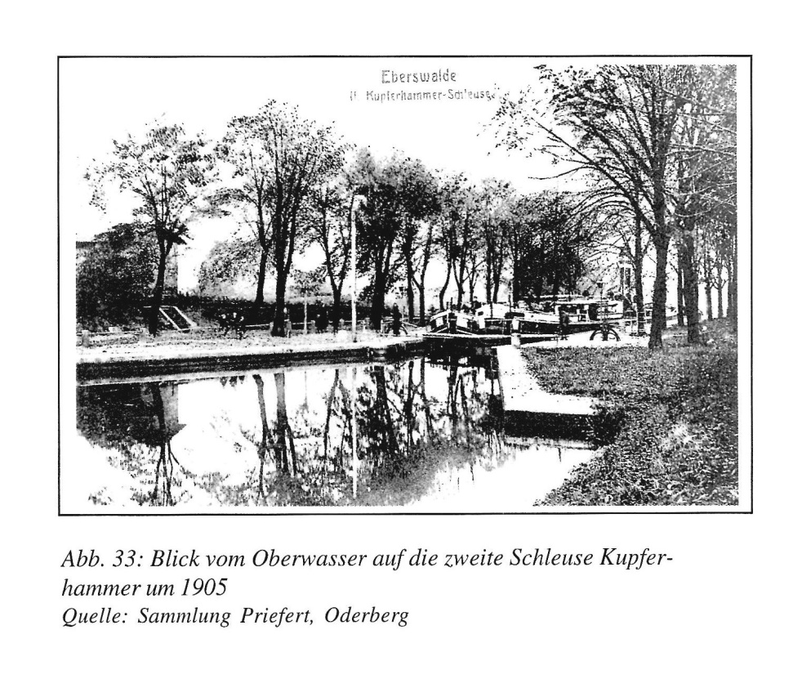
1. The Finow Canal in the past
The Kupferhammer Lock in Eberswalde around 1905
Quelle: Sammlung Priefert, Oderberg

Slide 8
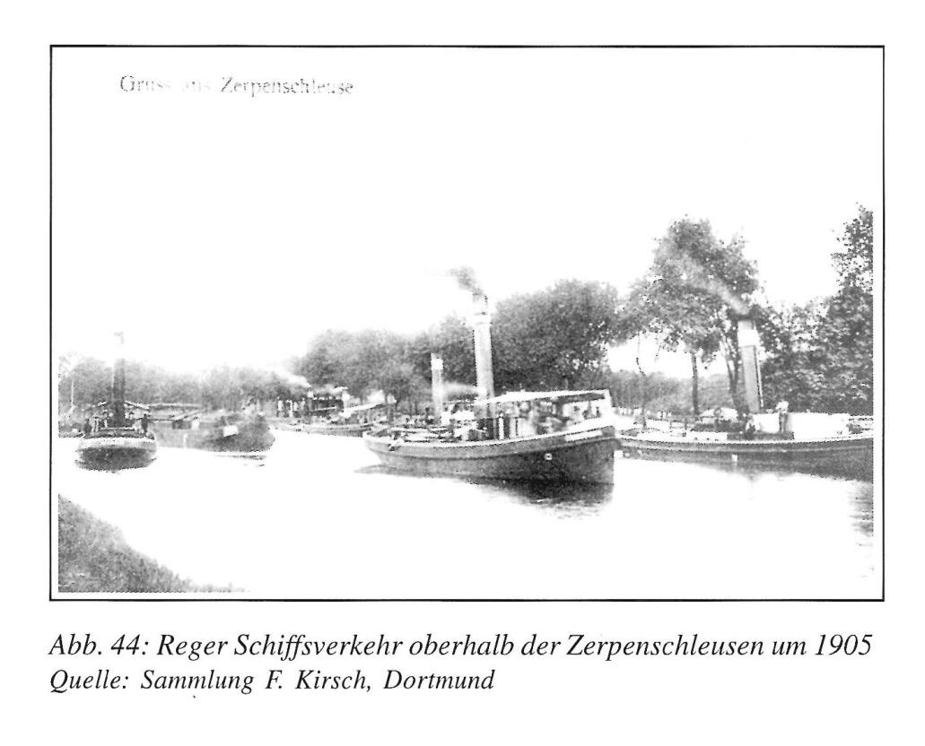
1. The Finow Canal in the past
Busy shipping at the Zerpenschleusen around 1905
Quelle: Sammlung F. Kirsch, Dortmund

Slide 9
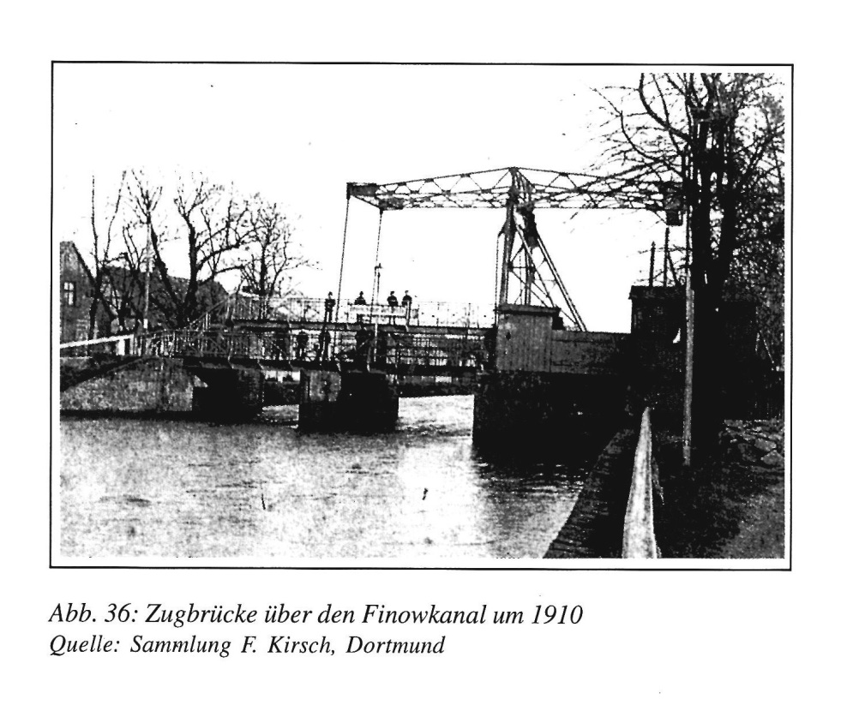
1. The Finow Canal in the past
Drawbridge over theFinow Canal around 1910
Quelle: Sammlung F. Kirsch, Dortmund

Slide 10
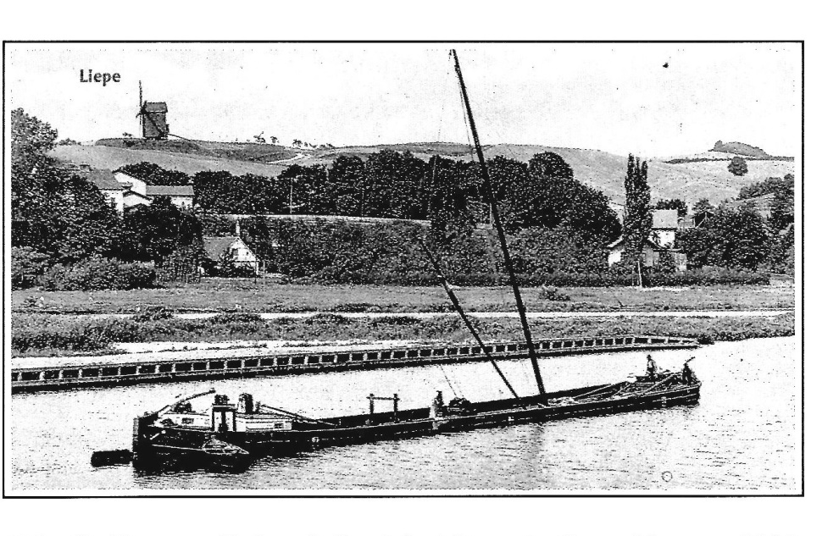
1. The Finow Canal in the past
A sailing construction specifically built for the canal in Liepe around 1910
Quelle: Sammlung Priefert, Oderberg

Slide 11
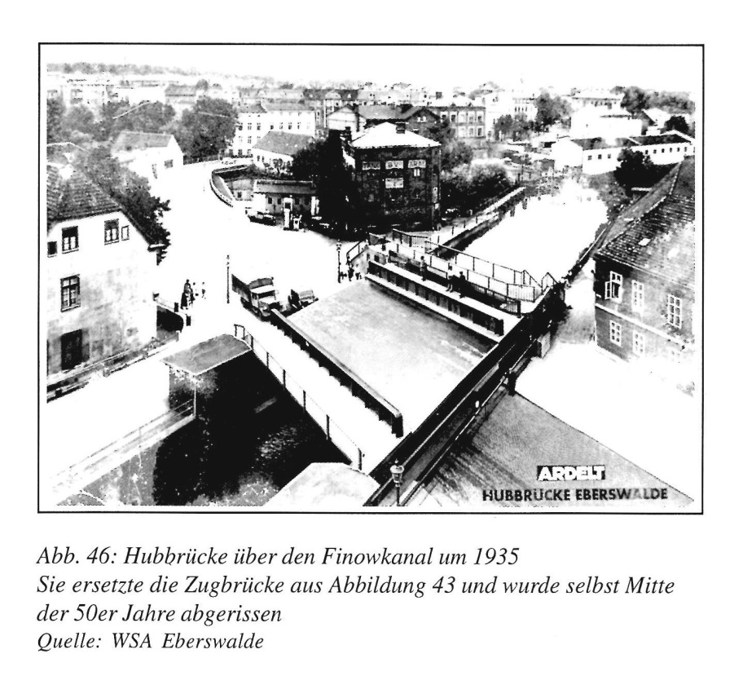
1. The Finow Canal in the past
A lift bridge over the Finow Canal around 1935
Quelle: WSA Eberswalde

Slide 12
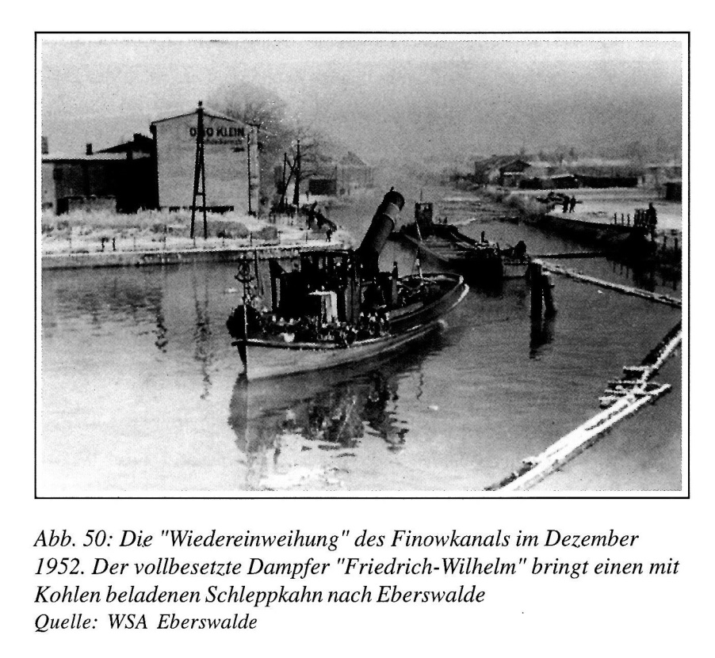
1. The Finow Canal in the past
The „reopening“ of the Finow Canal in December 1952
Quelle: WSA Eberswalde

Slide 13
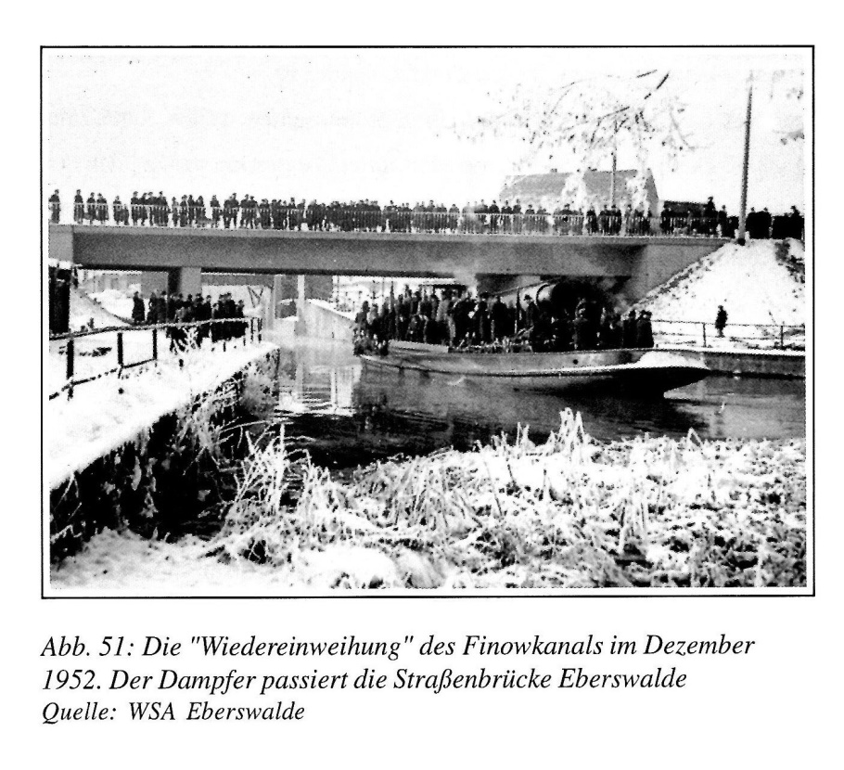
1. The Finow Canal in the past
The „reopening“ of the Finow Canals im December 1952
Quelle: WSA Eberswalde

Slide 14
Contents
1. The Finow Canal in the past
2. The Finow Canal today
3. The locks along the Canal
4. Solarboat project at the Canal

Slide 15
2. The Finow Canal today
since 1998 the Canal mainly serves as a tourist destination
along the Canal are large forests and many lakes
it is also very popular with water sportsmen
it is 32 km long and has a gradient of 36 m
its 12 locks are operated by hand
the service is offered from 1st May until 30th September

Slide 16
Contents
1. The Finow Canal in the Past
2. The Finow Canal today
3. The locks along the Canal
4. Solarboat project at the Canal

Slide 17
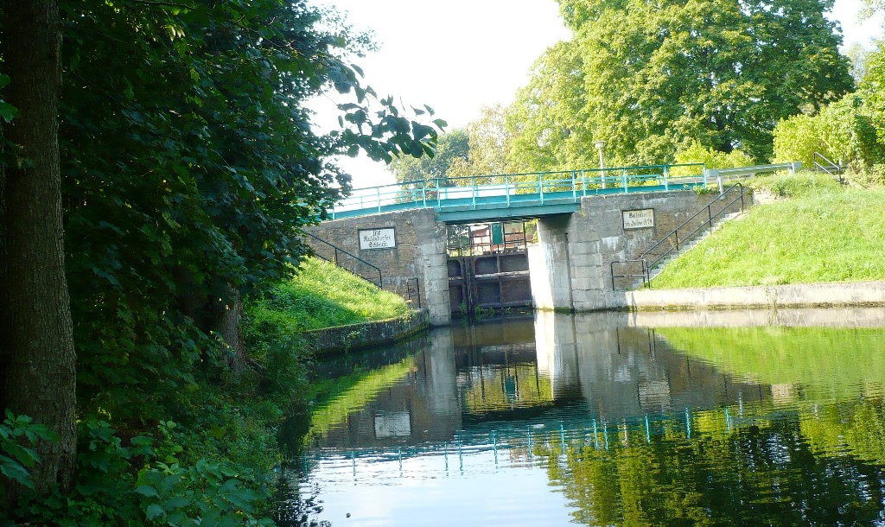
3. The Locks along the Canal
1
Ruhlsdorfer Schleuse 2014
Quelle: P. Scholler

Slide 18
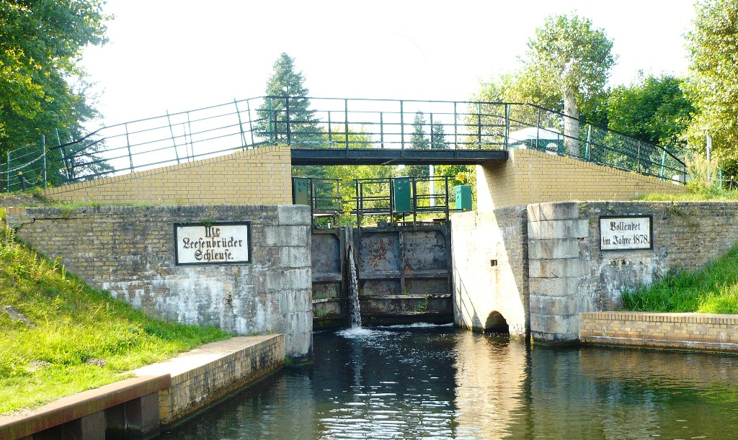
3. The Locks along the Canal
2
Leesenbrücker Schleuse 2014
Quelle: P. Scholler

Slide 19
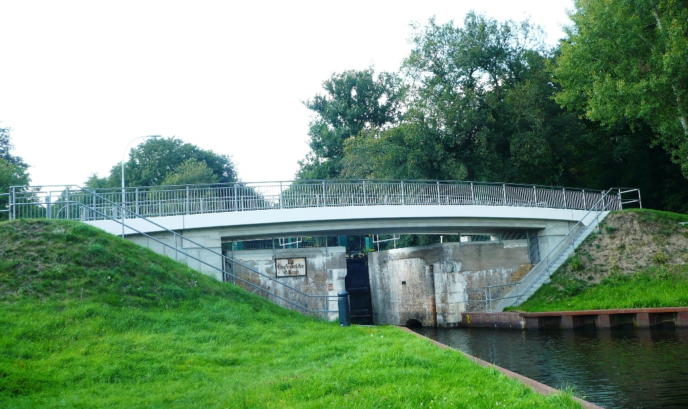
3. The Locks along the Canal
3
Grafenbrücker Schleuse 2014
Quelle: P. Scholler

Slide 20
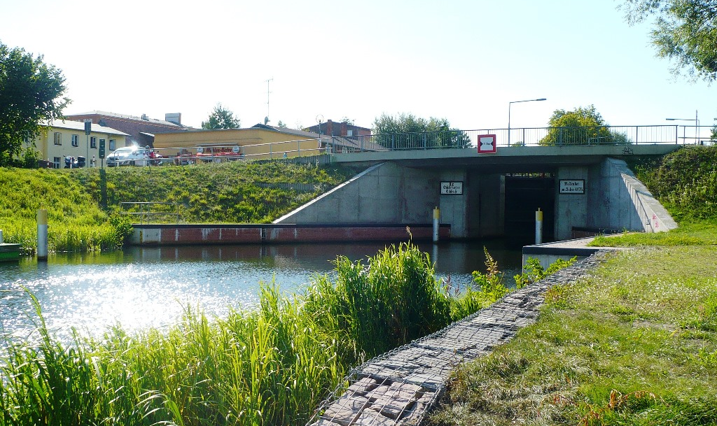
3. The Locks along the Canal
4
Schöpffurther Schleuse 2014
Quelle: P. Scholler

Slide 21
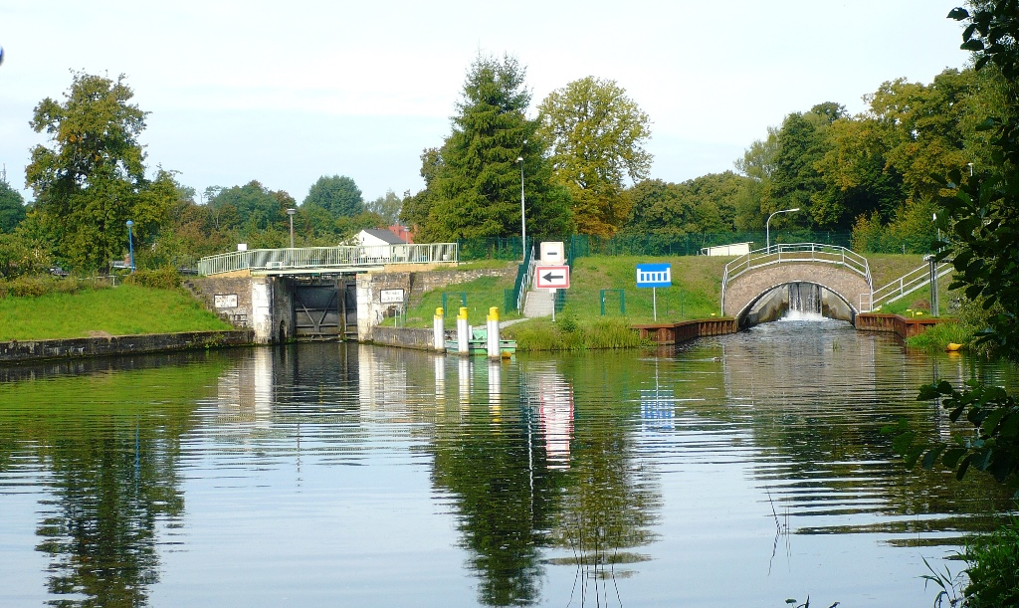
3. The Locks along the Canal
5
Heegermühler Schleuse 2014
Quelle: P. Scholler

Slide 22
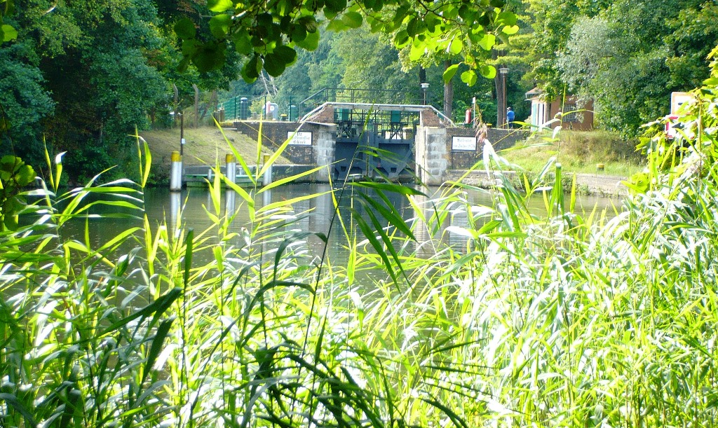
3. The Locks along the Canal
6
Wolfswinkler Schleuse 2014
Quelle: P. Scholler

Slide 23
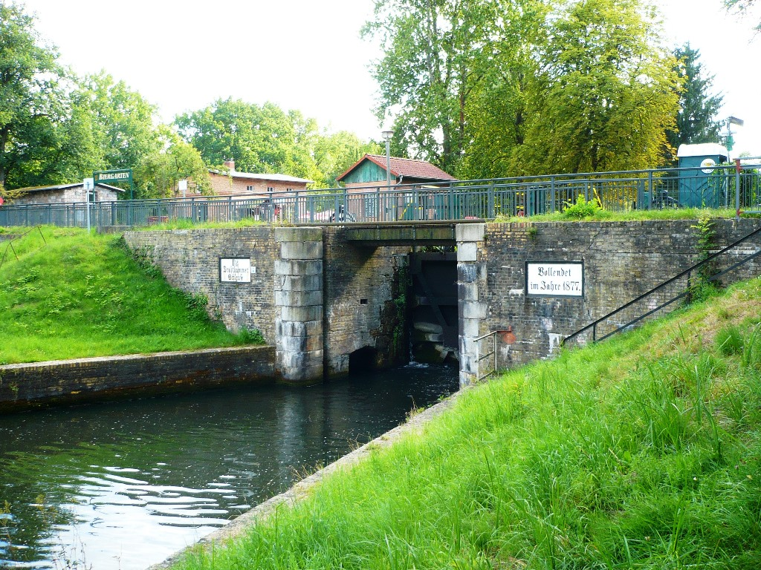
3. The Locks along the Canal
7
Drahthammer Schleuse 2014
Quelle: P. Scholler

Slide 24
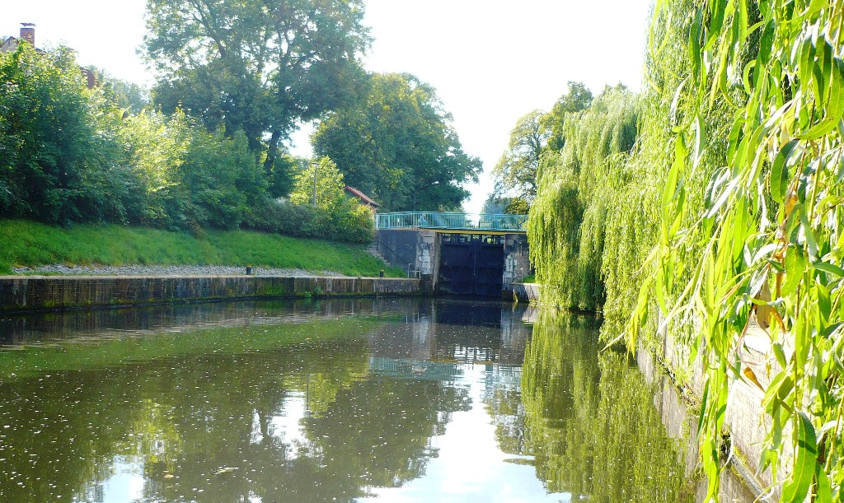
3. The Locks along the Canal
8
Kupferhammer Schleuse 2014
Quelle: P. Scholler

Slide 25
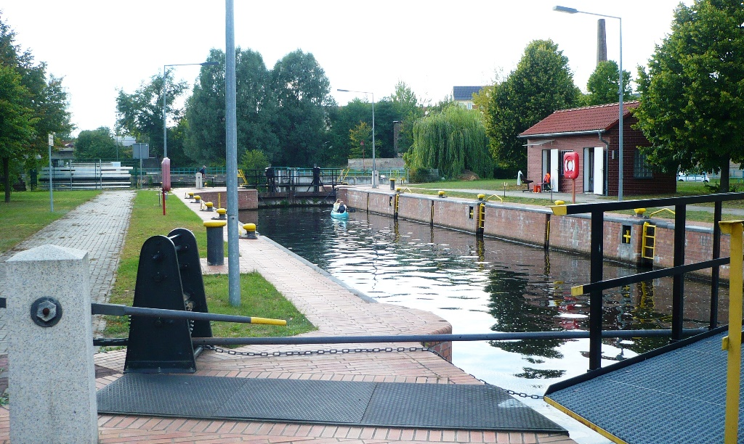
3. The Locks along the Canal
9
Eberswalder Schleuse 2014
Quelle: P. Scholler

Slide 26
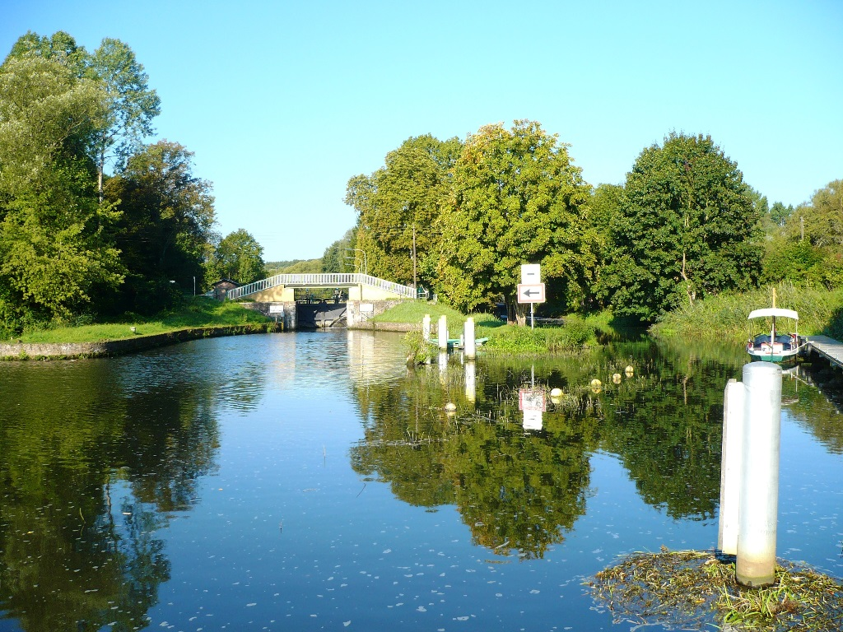
3. The Locks along the Canal
10
Ragöser Schleuse 2014
Quelle: P. Scholler

Slide 27
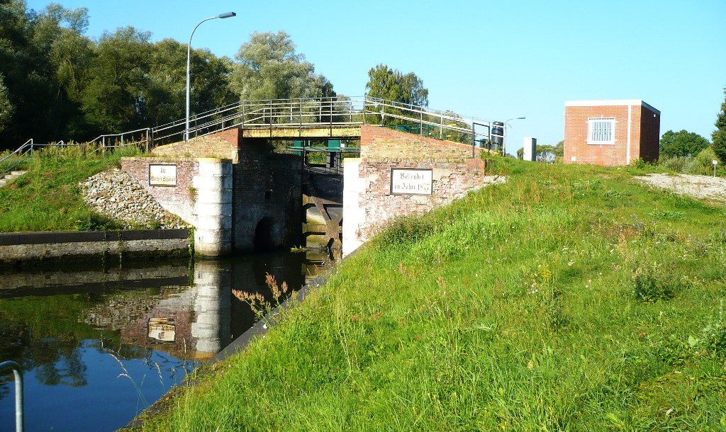
3. The Locks along the Canal
11
Stecher Schleuse 2014
Quelle: P. Scholler

Slide 28
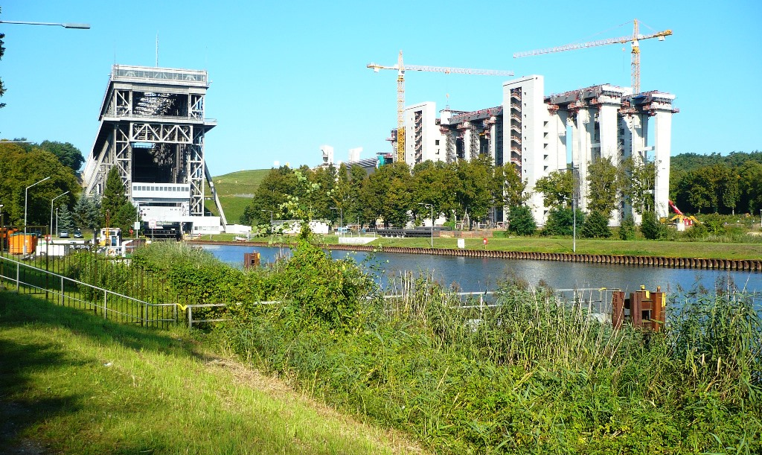
3. The Locks along the Canal
Schiffshebewerk Niederfinow 2014
Quelle: P. Scholler

Slide 29
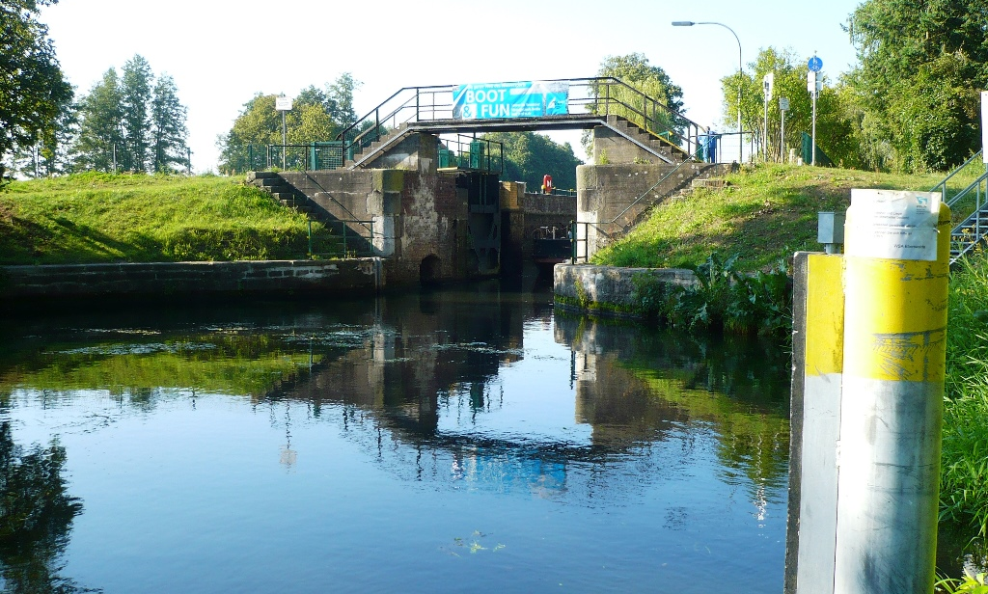
3. The Locks along the Canal
12
Lieper Schleuse 2014
Quelle: P. Scholler

Slide 30
Contents
1. The Finow Canal in the past
2. The Finow Canal today
3. The Locks along the Canal
4. Solarboat project at the Canal

Slide 31
4. Solarboat project at the Canal
on 27th September the first solarboat regatta took place
students from Finowfurt School also took part in the competition on the Finow Canal
organizer ist professor H. Ginnow-Merkert (chairman of the Solarboat Organization Berlin-Brandenburg)

Slide 32
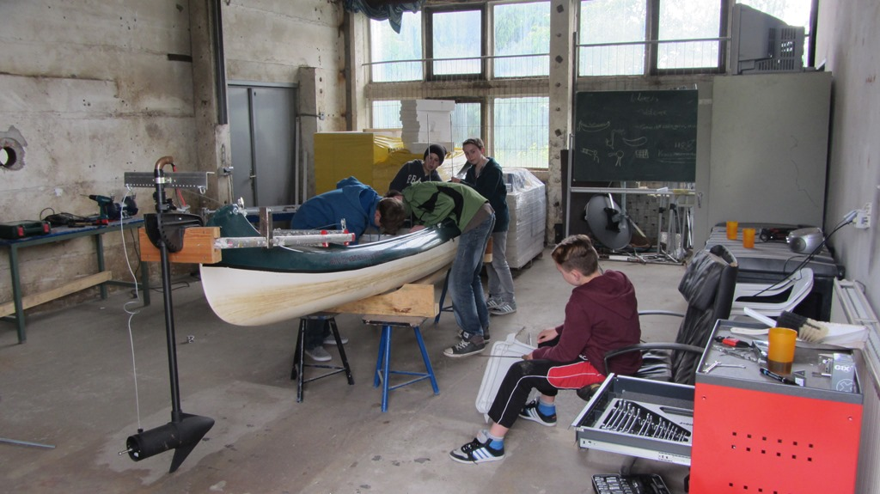
4. Solarboat project at the Canal

Slide 33
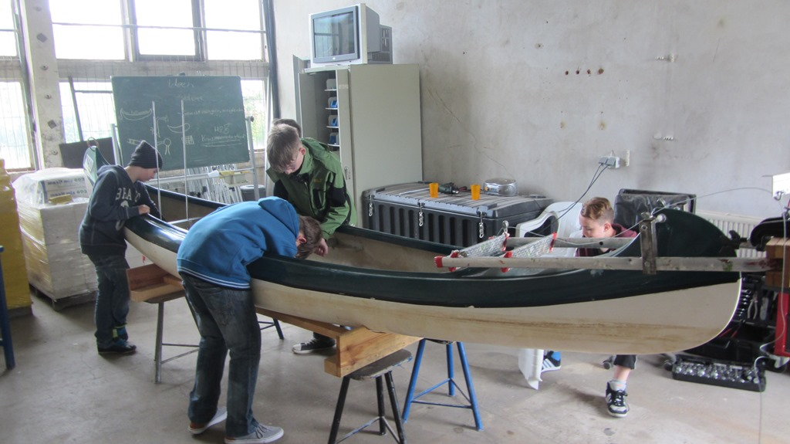
4. Solarboat project at the Canal

Slide 34
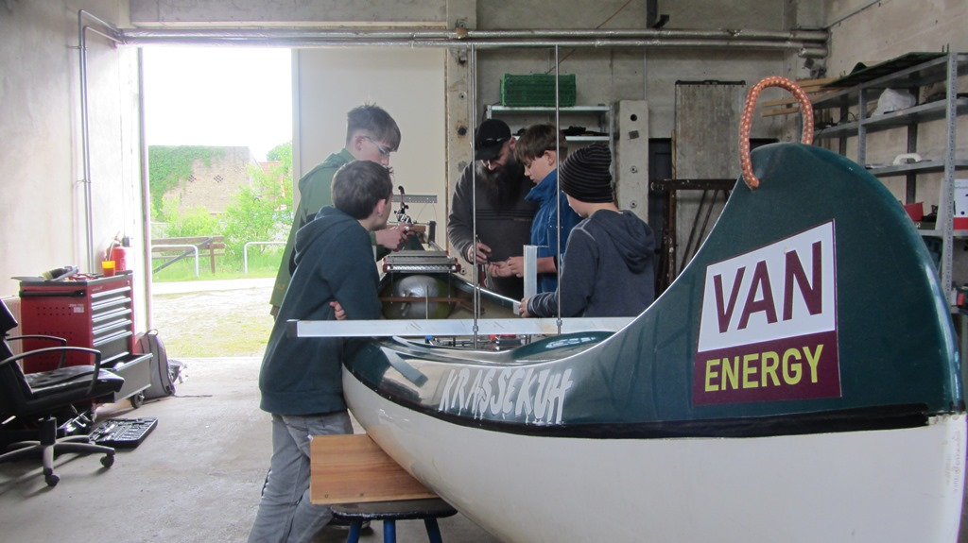
4. Solarboat project at the Canal

Slide 35
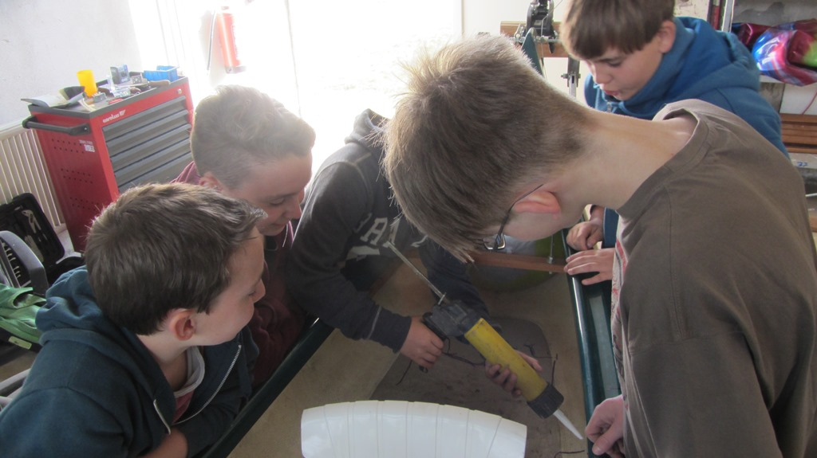
4. Solarboat project at the Canal

Slide 36
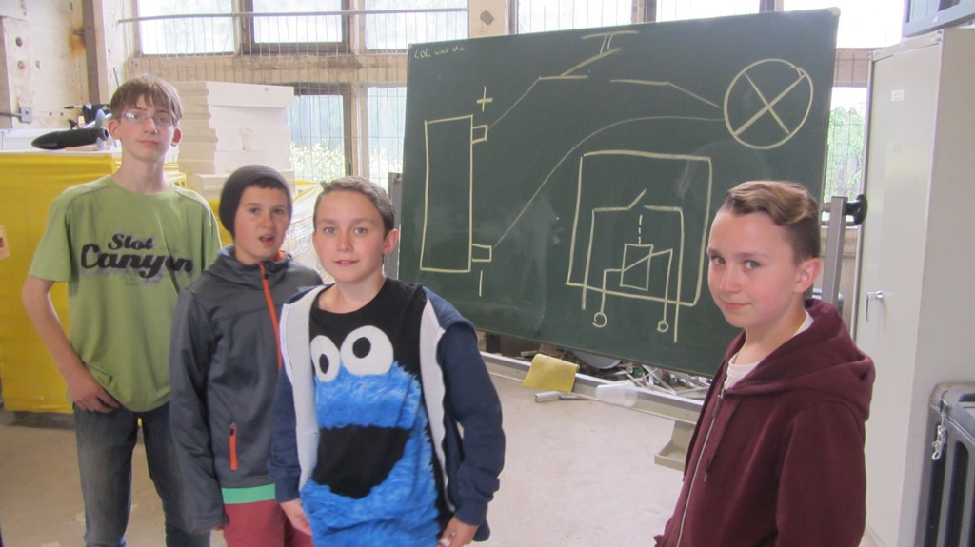
4. Solarboat project at the Canal

Slide 37
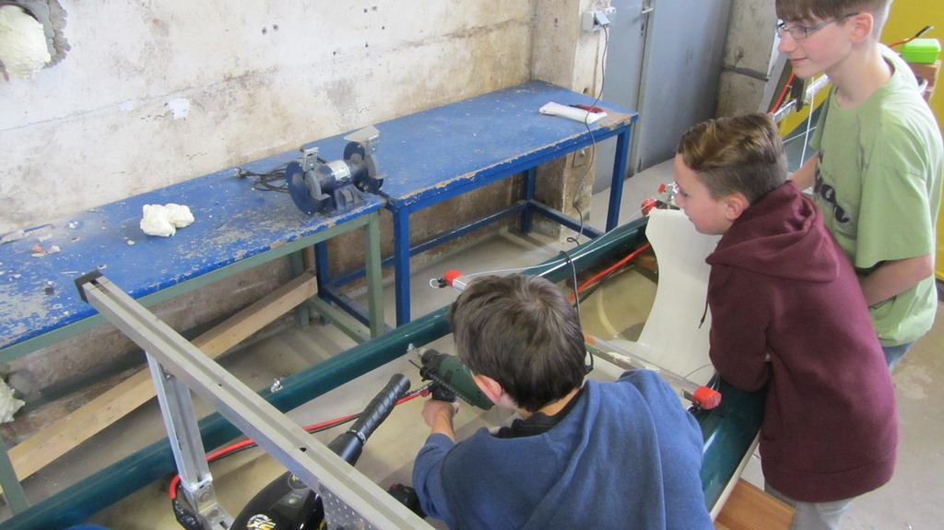
4. Solarboat project at the Canal

Slide 38
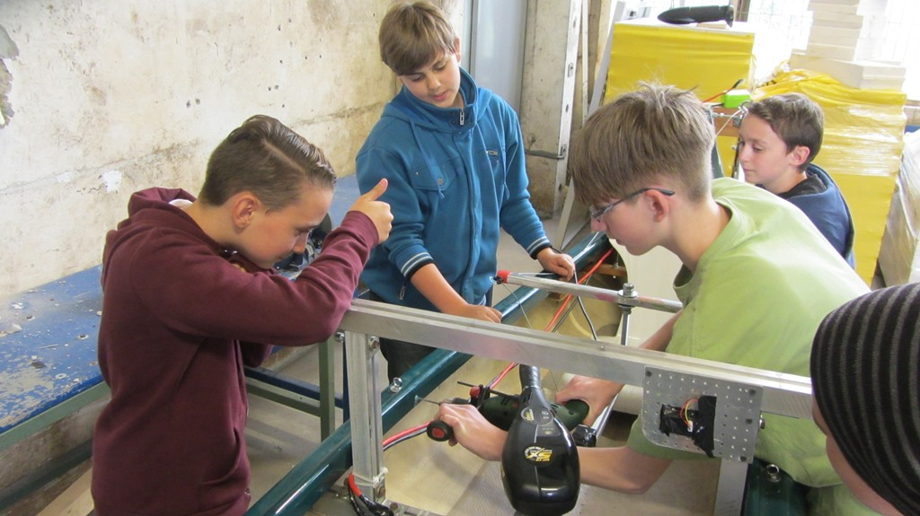
4. Solarboat project at the Canal

Slide 39
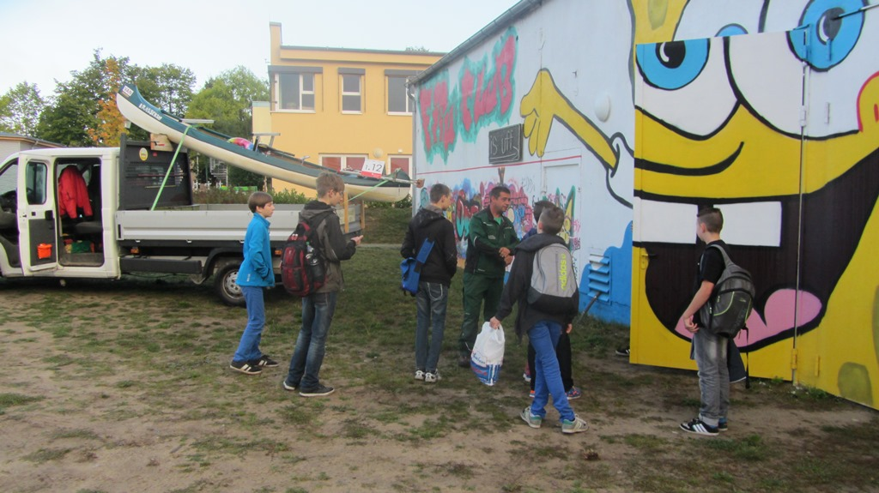
4. Solarboat project at the Canal

Slide 40
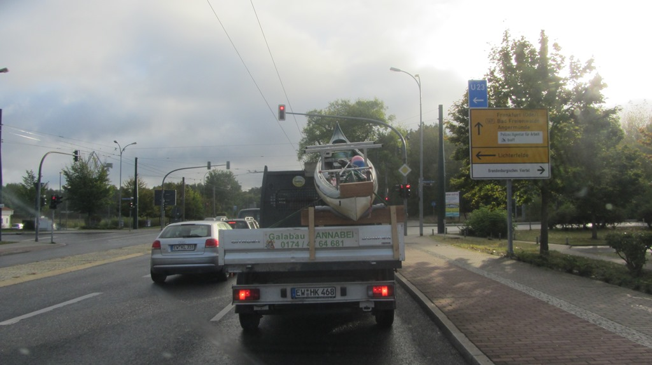
4. Solarboat project at the Canal

Slide 41
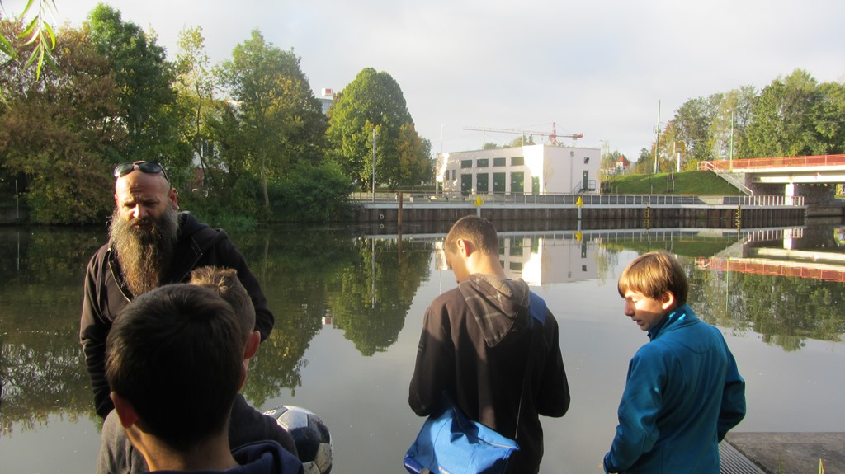
4. Solarboat project at the Canal

Slide 42
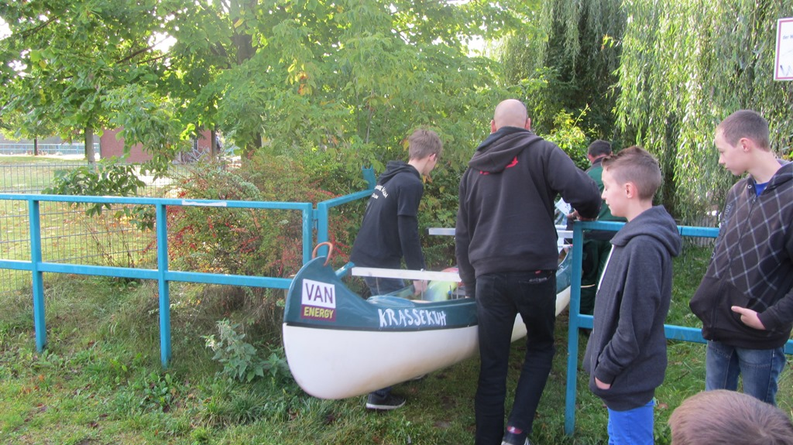
4. Solarboat project at the Canal

Slide 43
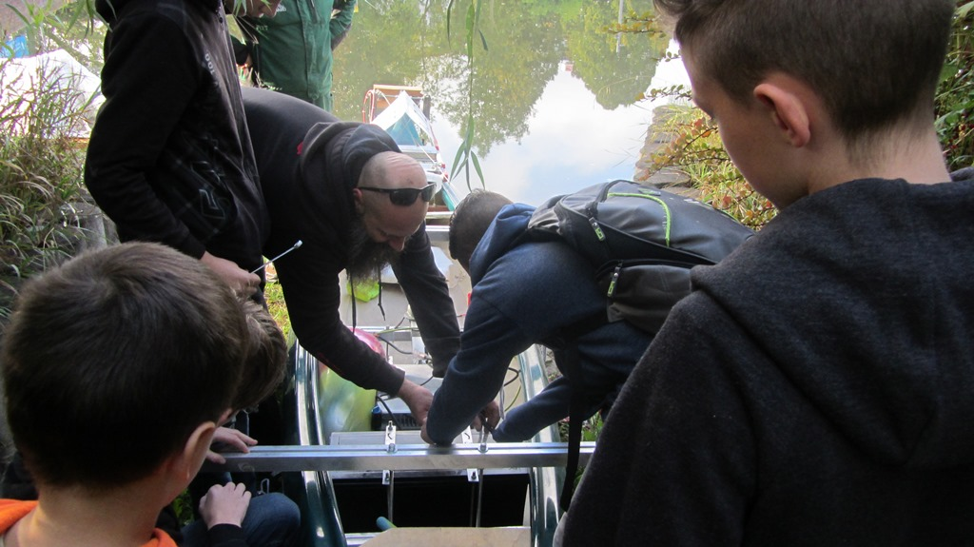
4. Solarboat project at the Canal

Slide 44
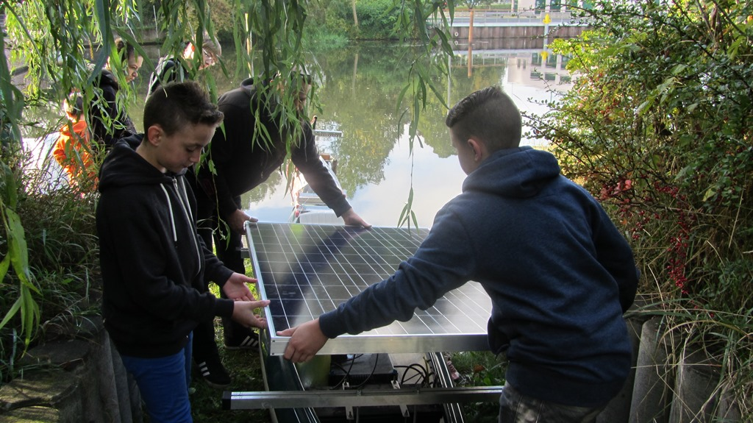
4. Solarboat project at the Canal

Slide 45
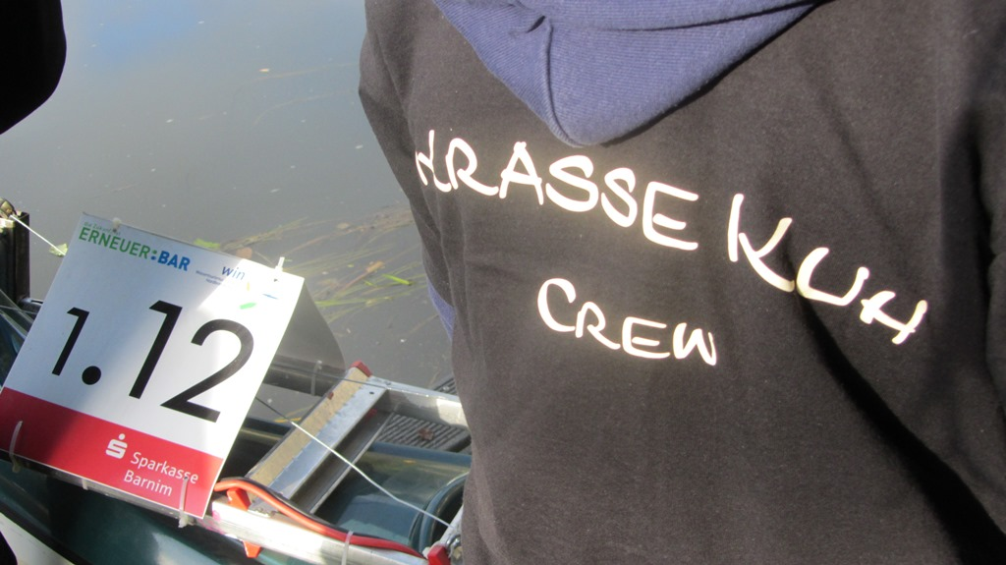
4. Solarboat project at the Canal

Slide 46
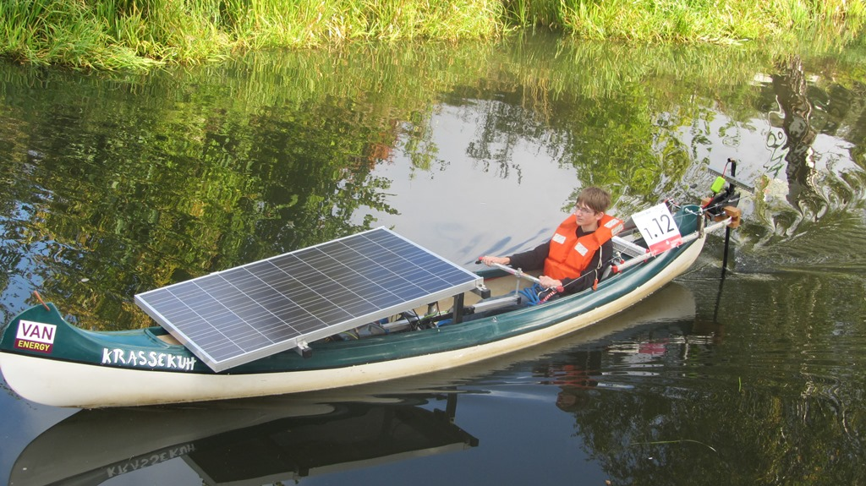
4. Solarboat project at the Canal

Slide 47
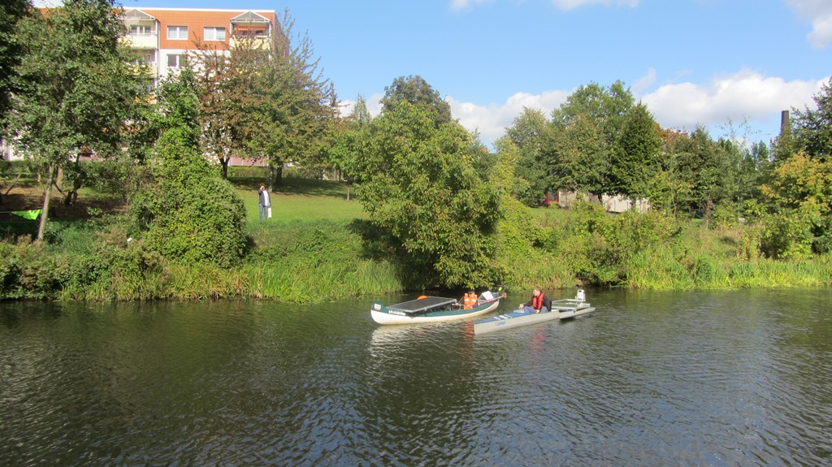
4. Solarboat project at the Canal

Slide 48
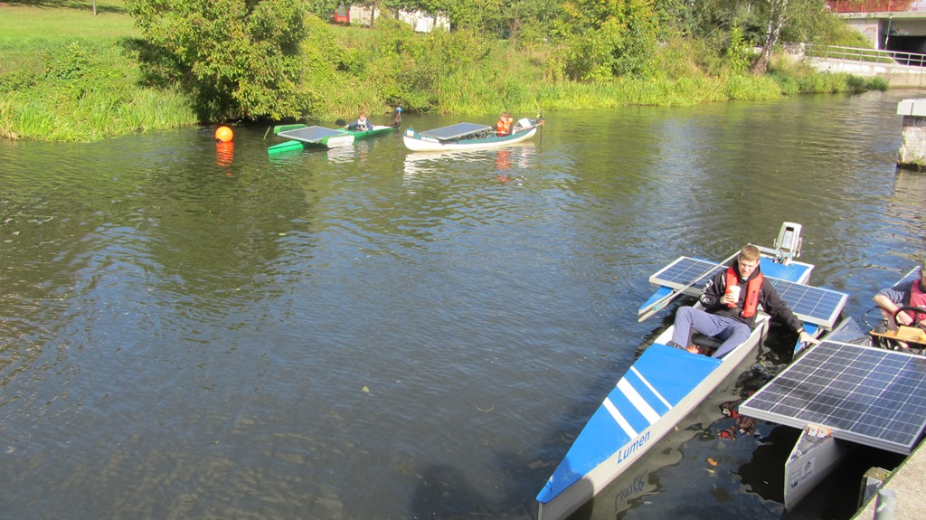
4. Solarboat project at the Canal

Slide 49
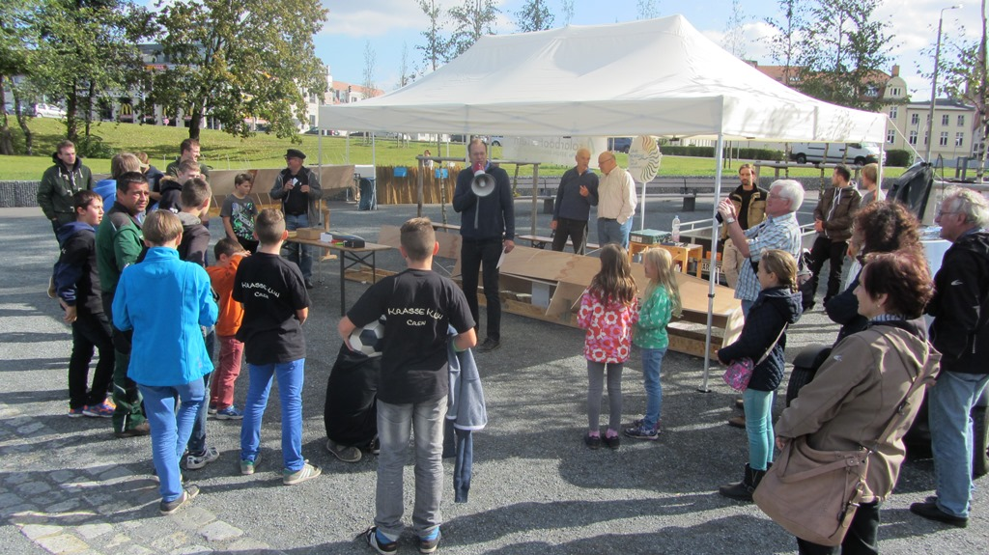
4. Solarboat project at the Canal

Slide 50
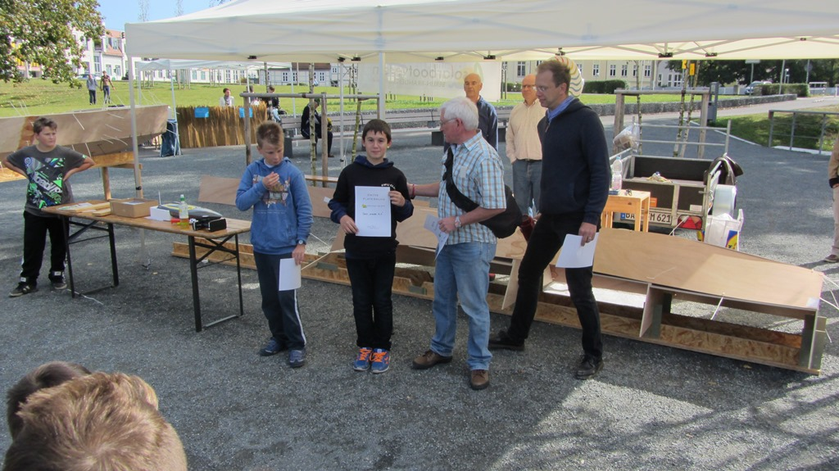
4. Solarboat project at the Canal

Slide 51
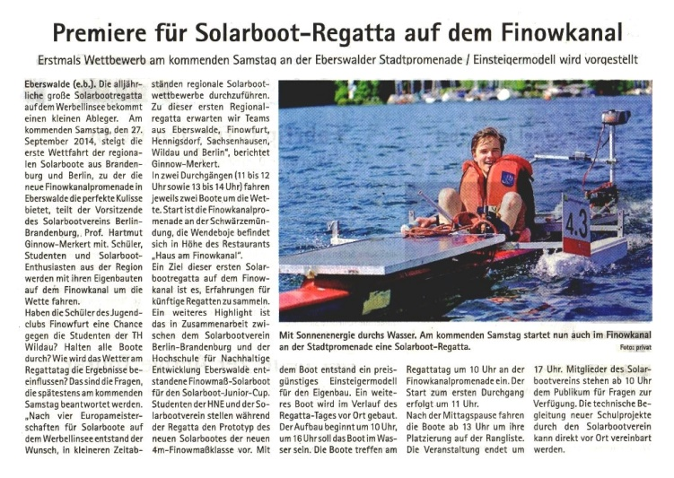
4. Solarboat project at the Canal
Quelle: Blitz, 18.09.2014

Slide 52
The Finow Canal
Thank you very much for your attention.

