Slide 1
Finowfurt School
Comenius project
19.09.-26.09.2013

Slide 2
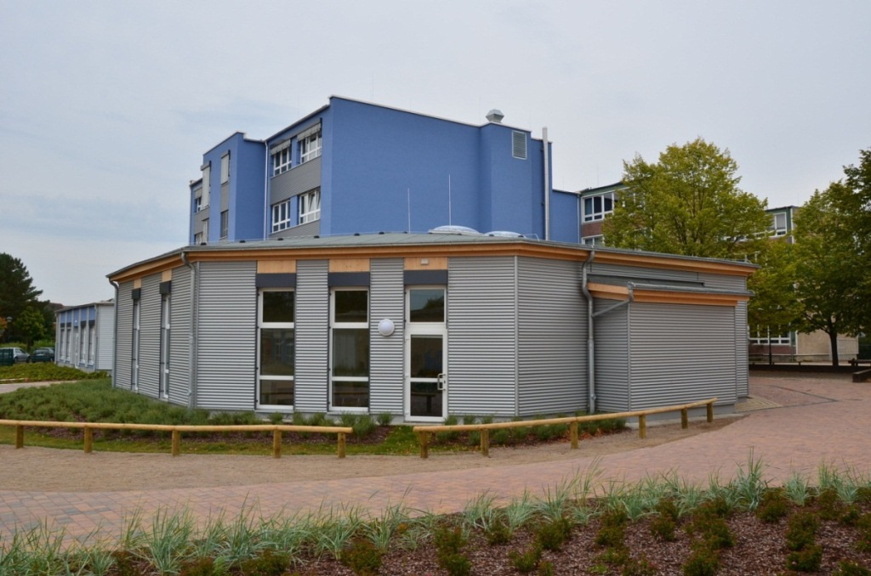
Our School

Slide 3
Contents
School building and rooms
Assembly hall
Grounds
Youth club
Schoolmanagement and teacher
School
Activities
Special Days

Slide 4
1. School building and rooms
Assembly
Gym
Computer rooms
Techniques and craft rooms
Class rooms
Cafeteria
Office
Homework room
Library

Slide 5
1.1. Timetable
lesson | time | minutes
open beginning | 7.30-8.00 | 30 min
1. lesson | 8.00-9.00 | 60 min
breakfest | 9.00-9.30 | 30 min
2. lesson | 9.30-10.30 | 60 min
break | 10.30-10.40 | 10 min
3. lesson | 10.40-11.40 | 60 min
lunch | 11.40-12.30 | 50 min
4. lesson | 12.30-13.30 | 60 min
break | 13.30-13.40 | 10 min
5. lesson | 13.40-14.40 | 60 min

Slide 6
2. Assembly
Lunchbreak
A space for entertaining when the weather is bad
Lunch
Serves for entertainment purposes and school festivals
Serves to introduce of new classes

Slide 7
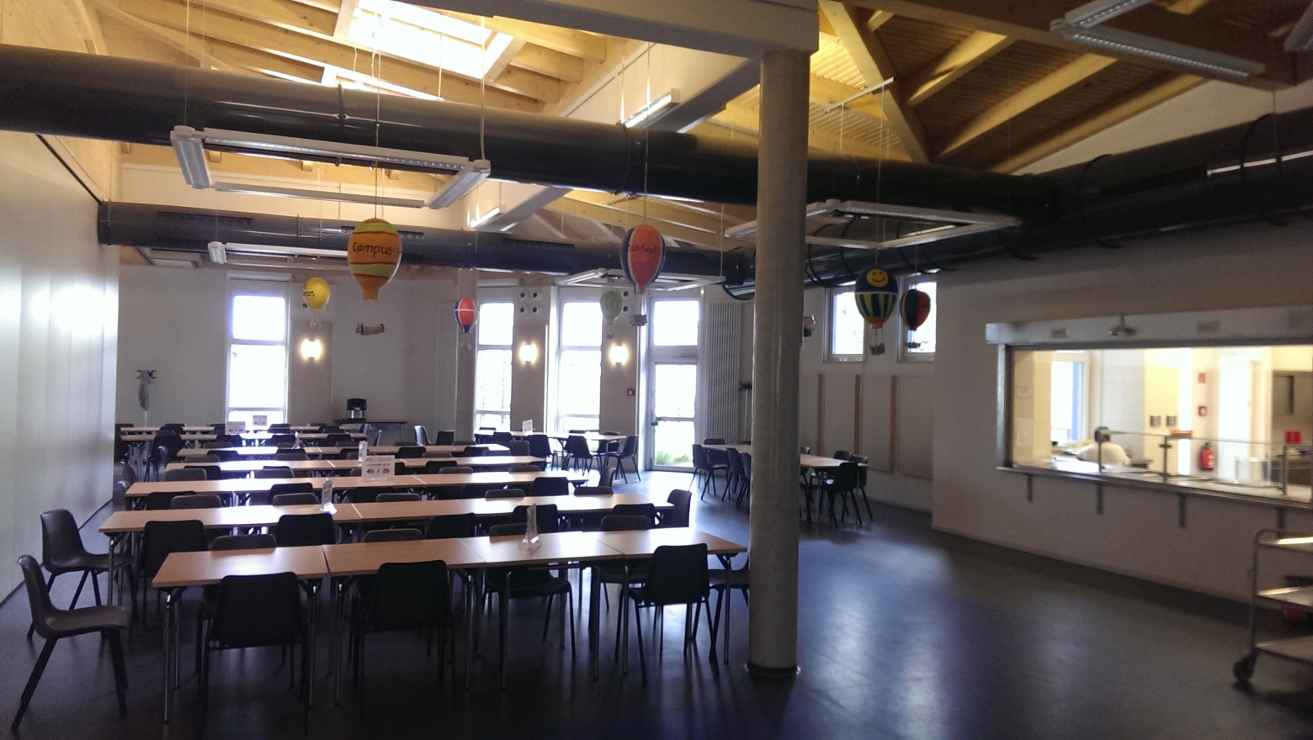
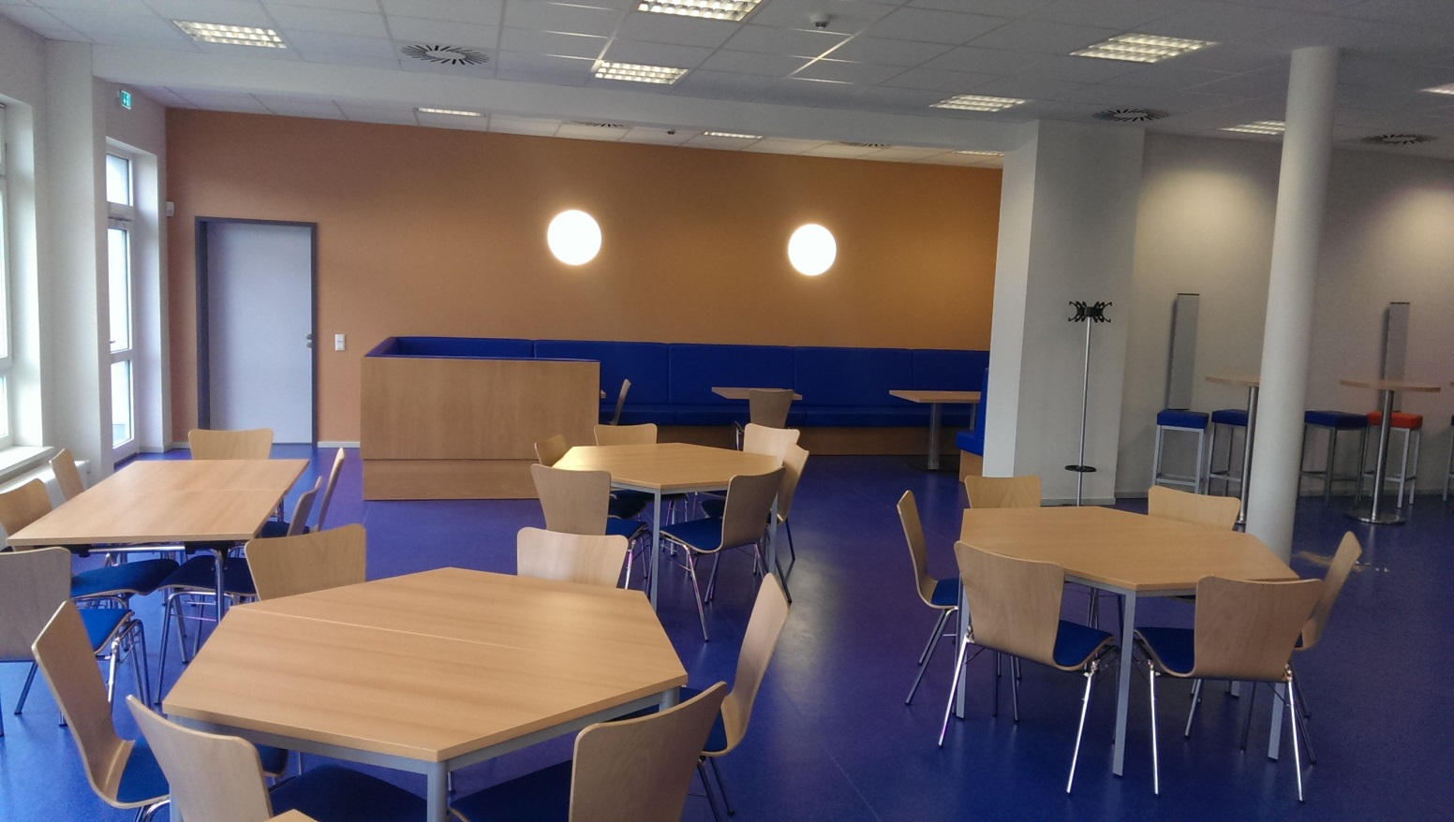
Assembly
Cafeteria

Slide 8
3. Ground
Sports hall
Sports field
Schoolyard
Playground
Youth club
After school club
Primary school

Slide 9
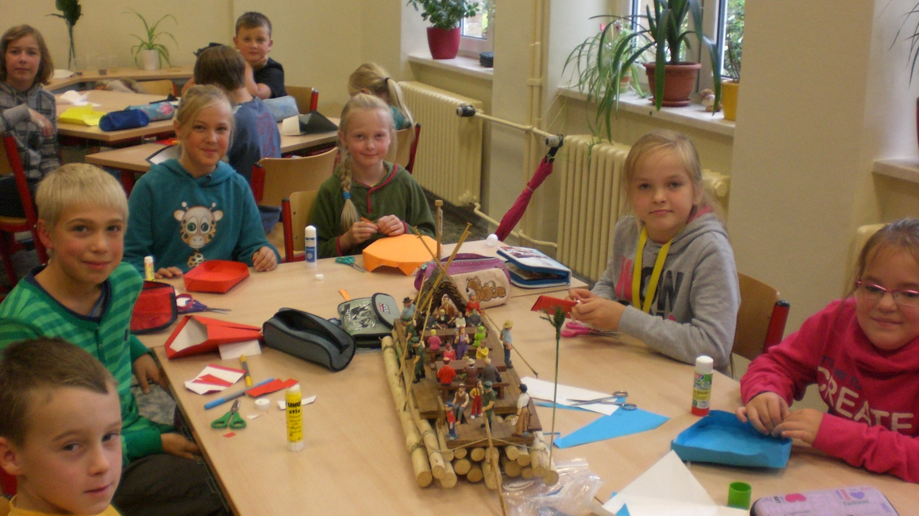
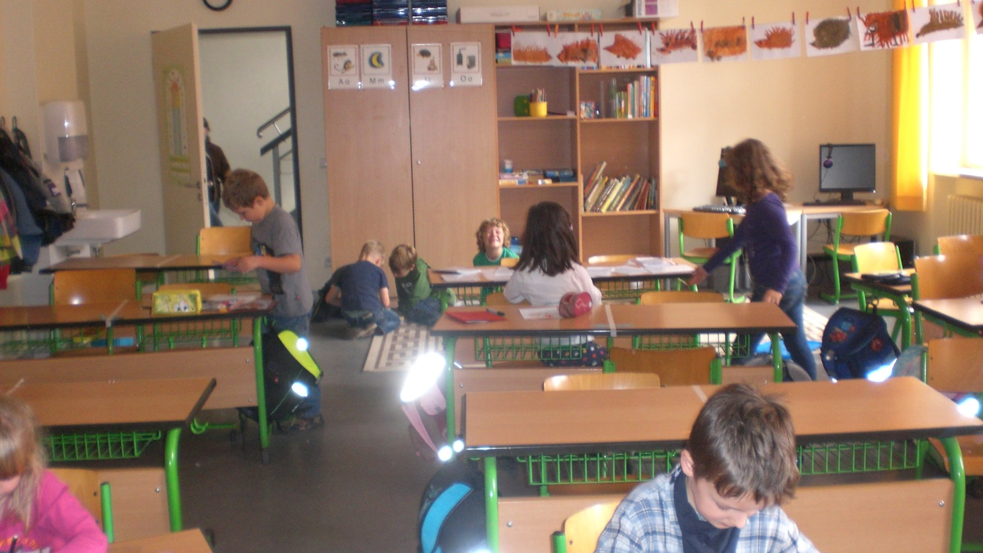
Primary school

Slide 10
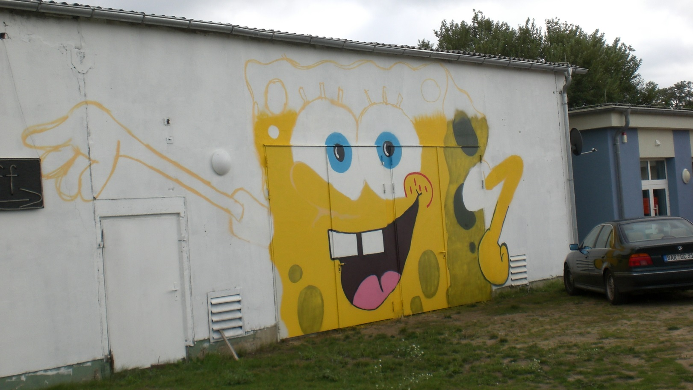
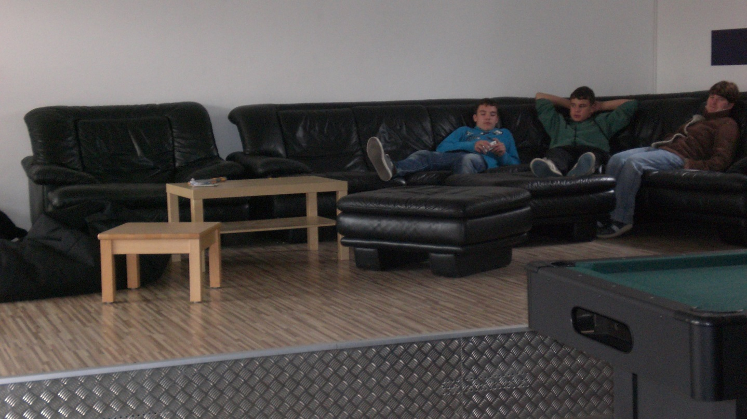
Youth club

Slide 11
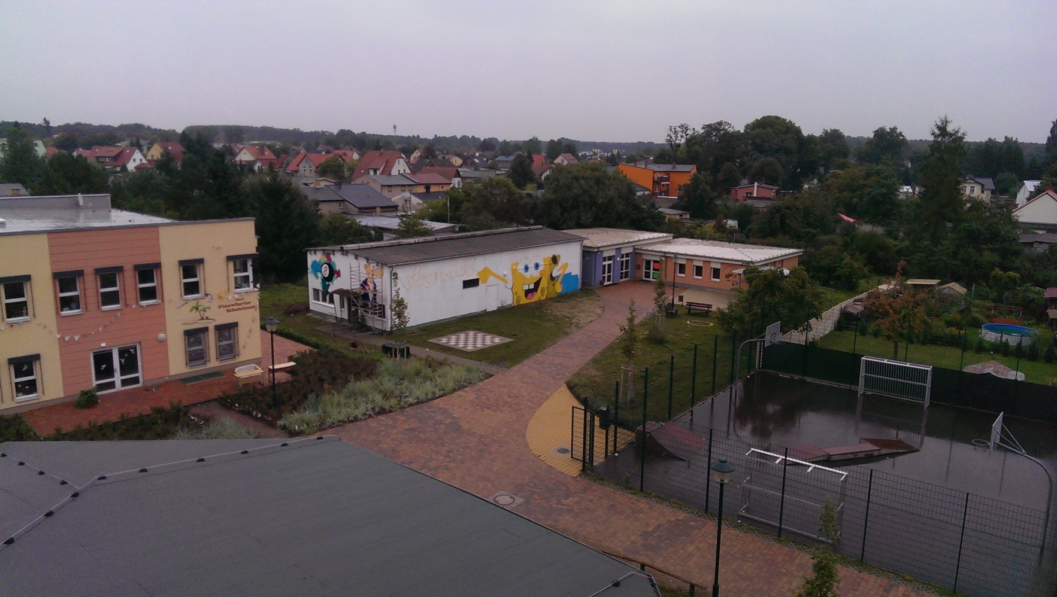
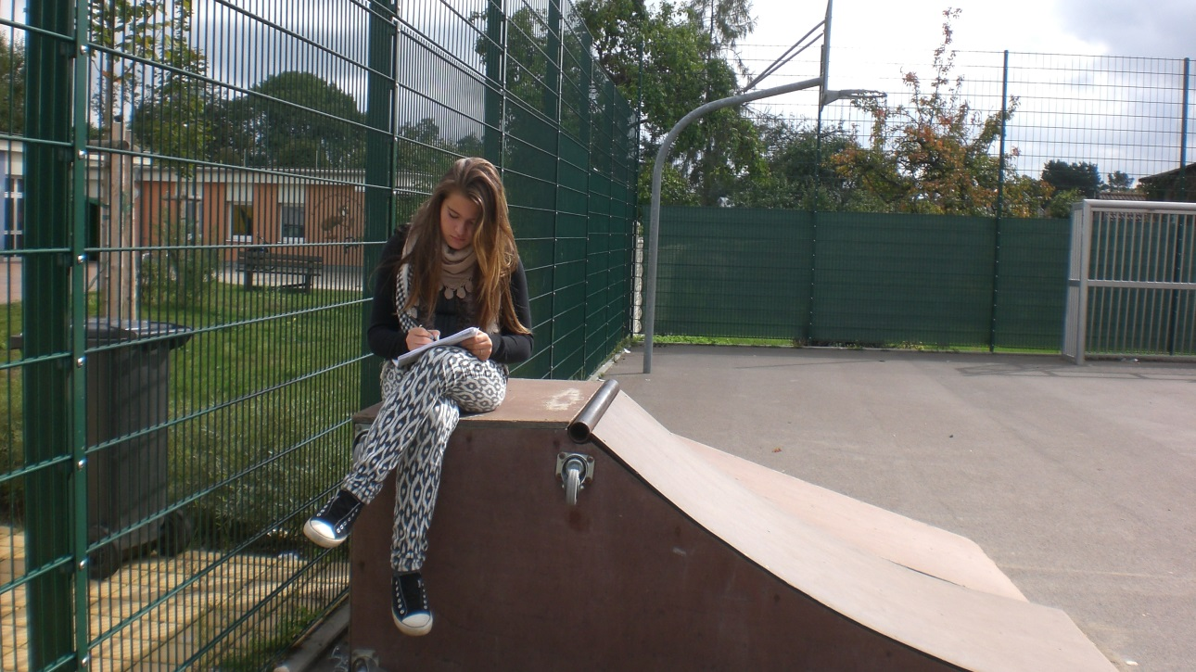
Youth club

Slide 12
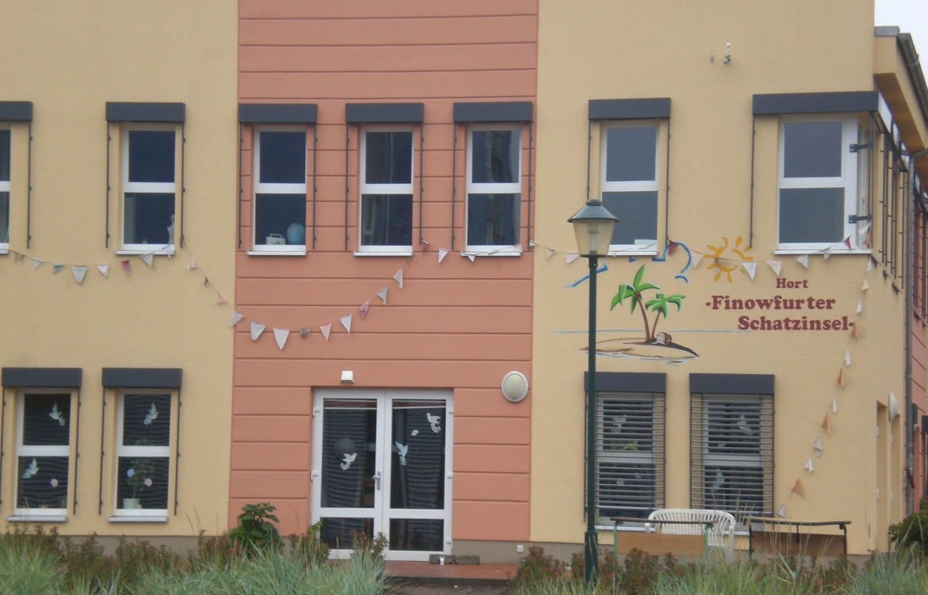
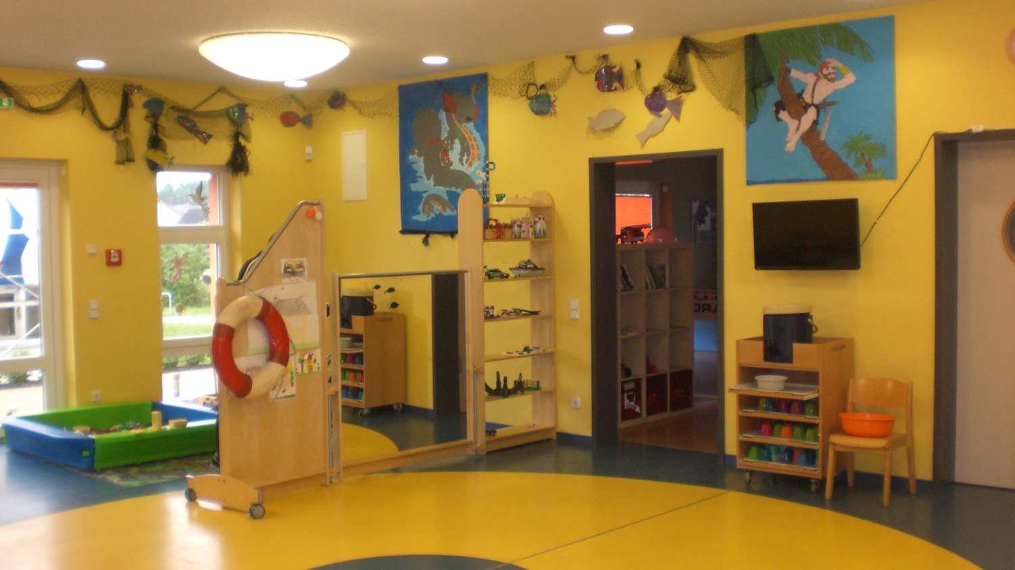
The young pupil do homework in the after school club. There, they have a lot of fun.
After school club

Slide 13
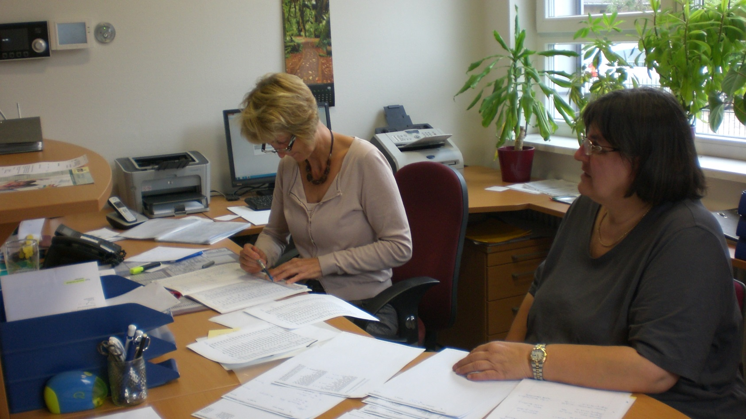
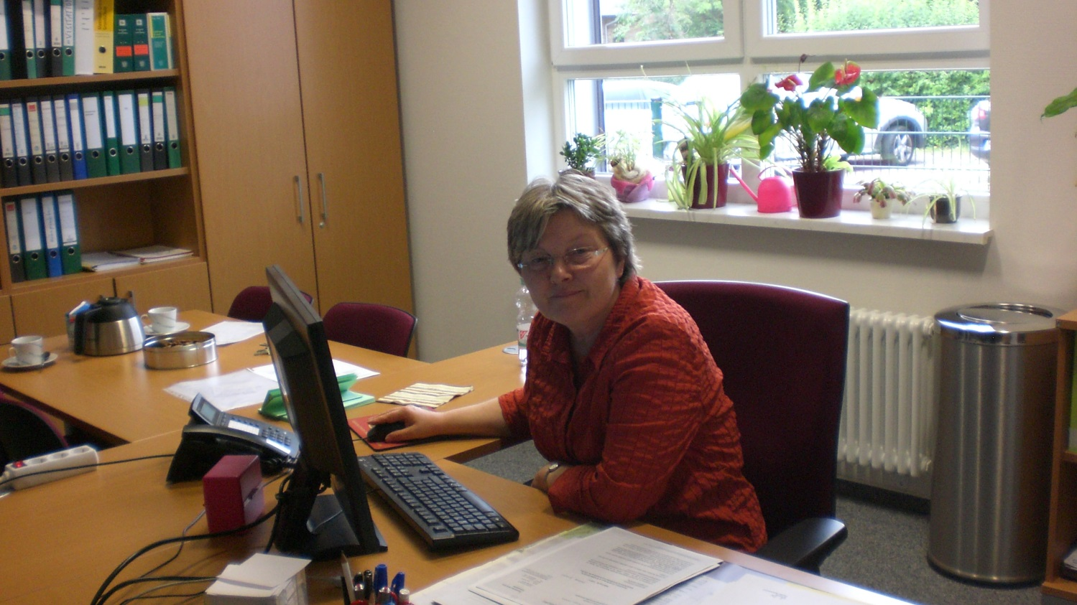
Office

Slide 14
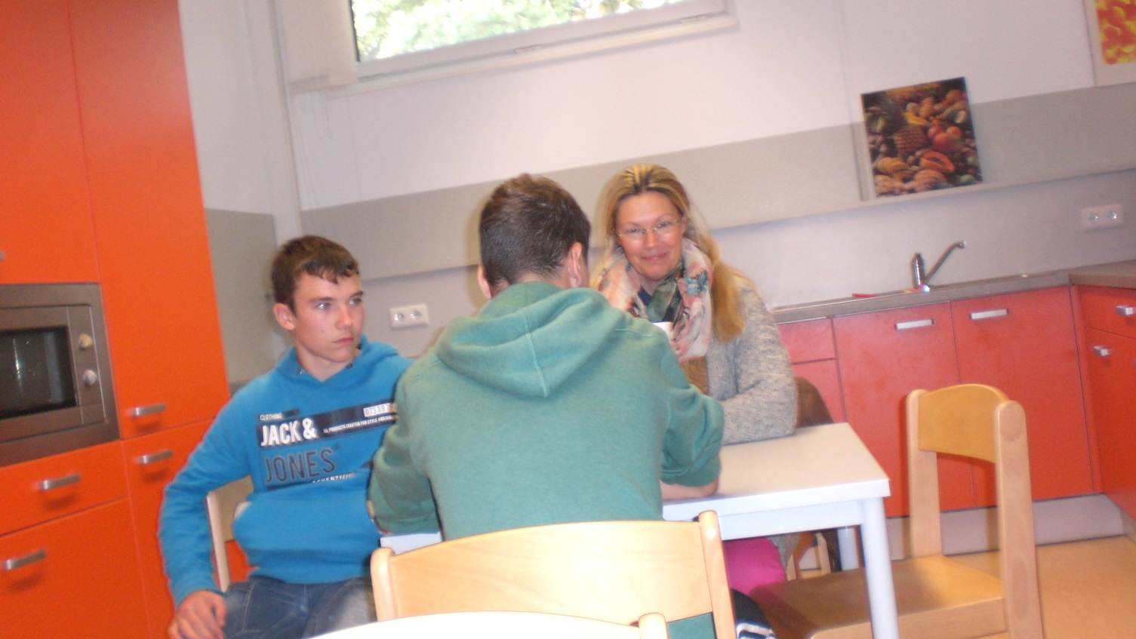
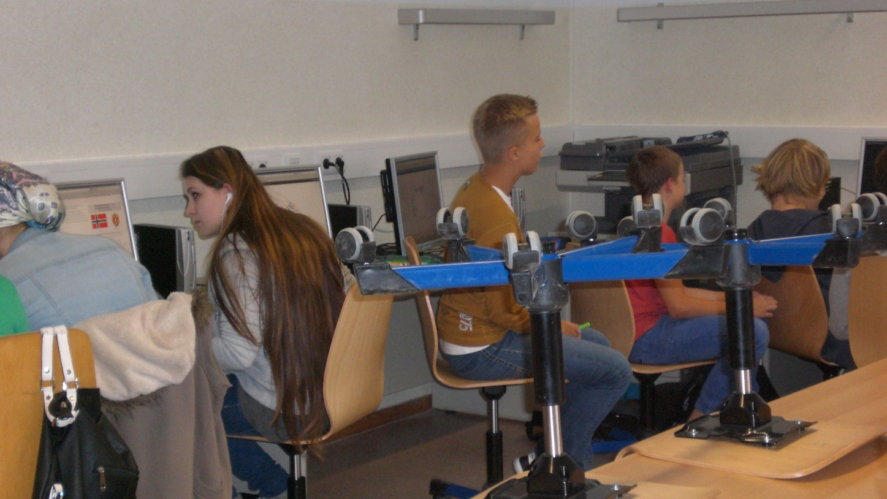
Computer-room and Kittchen

Slide 15
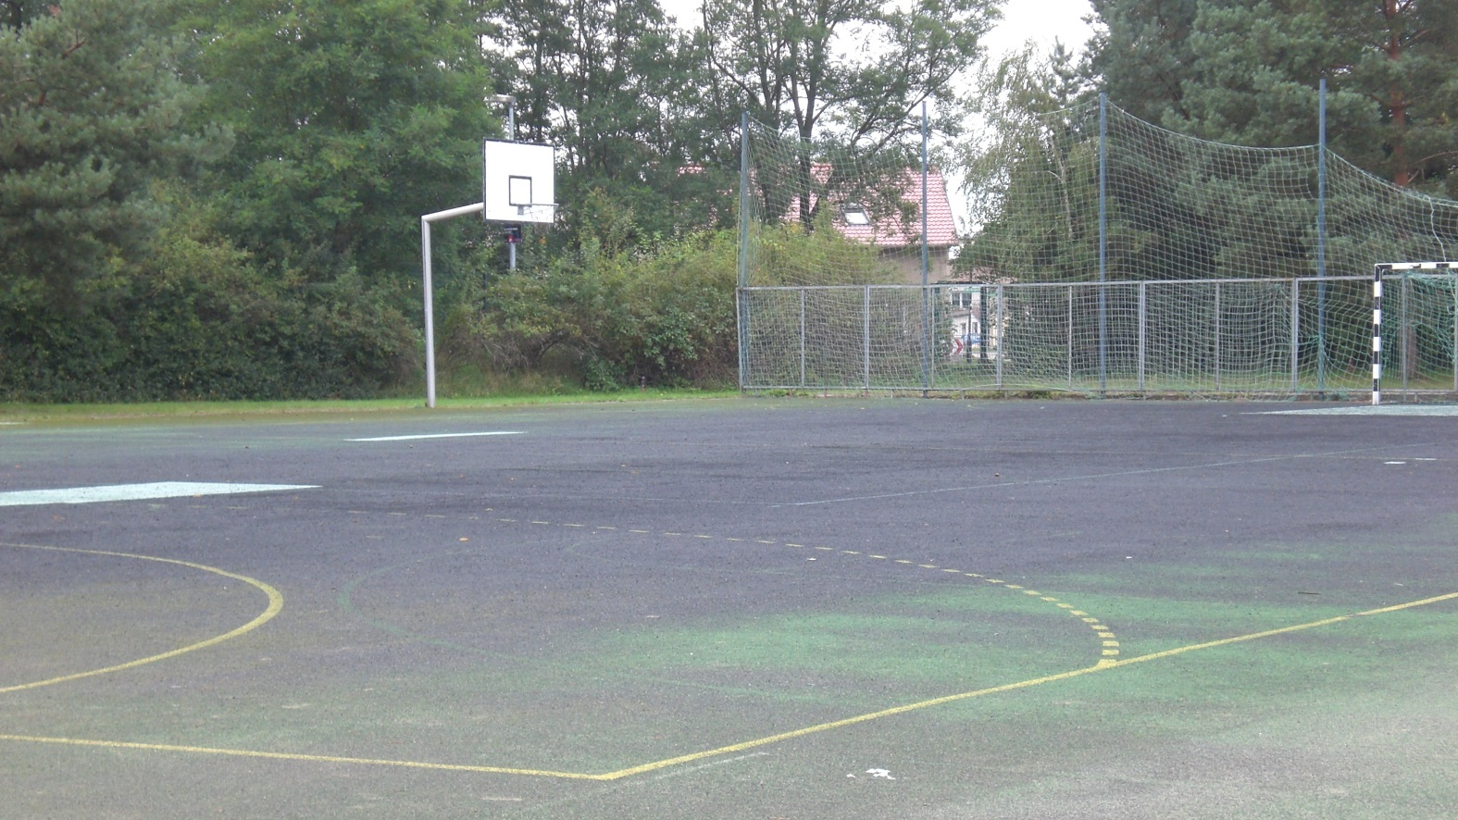
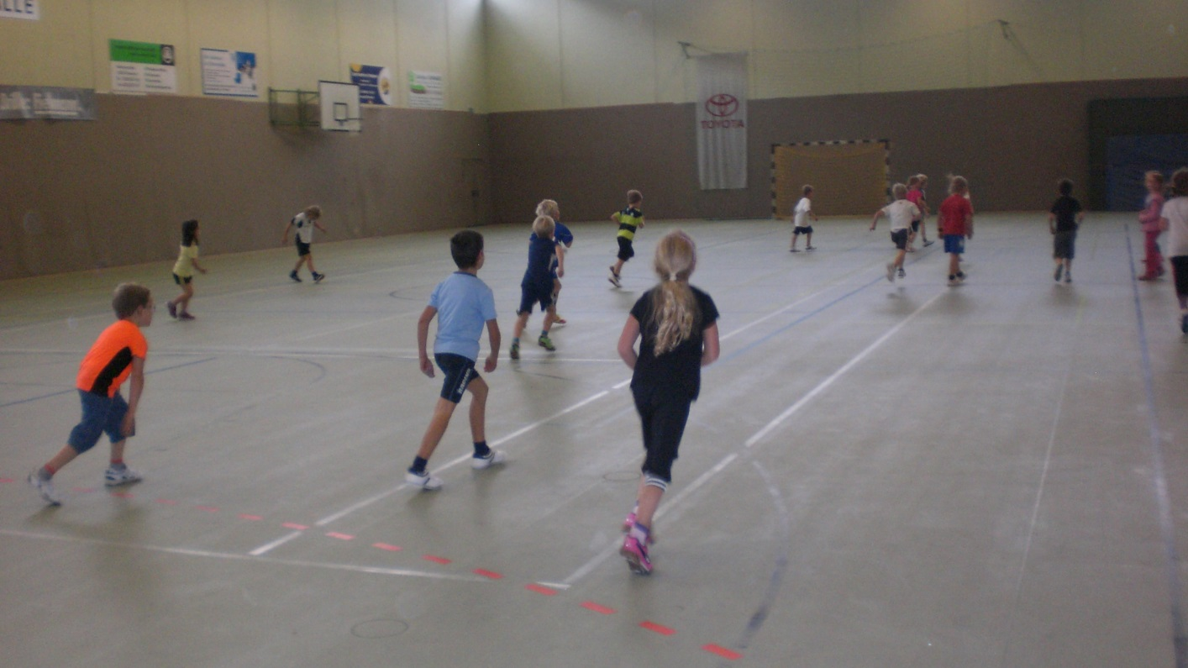
sports field and sports hall

Slide 16
4. Youth club
Club to chill
You can play there
There you can eat and drink baguettes, cola, ice and others
Listen to music
You can play poolbilliard and tabeltennis
There are a chillcoutch
The teenage club chef´s name is Joschi Bauer
There you can get a lot of fun
Activities are christians teach, cooking, backing, tinker

Slide 17
5. Schoolmanagement and teacher
Since 1996 Mrs. Kosanke is the headmistress of the school. Thanks to her support our school survived.
Mrs. Kupfer is the deputy headmistress of the school. She is managing the sequences of school. Once she was a pupil of this school. Since 1992 Mrs. Kupfer works as a teacher at the school Finowfurt.

Slide 18
6. School
The secondary school has 10 classes
The elementary school has 12 classes
430 pupil attend this school
37 teachers work here
Individual learning time (ILT)
  Time for homeworks, remedial classes, working and learning techniques

Slide 19
6. School
School leaving certificates
  FOR – training maturity
  EBR – extended training maturity
  FORQ – training maturity that allows to attend a grammar school
Abolition of the course-system
Learning in classes – we support each other

Slide 20
7. activities
Football tournament
Clubs
Activities with Polish partner schools
Day of open doors
Snow-sports project
Polish-German youth meeting
School without racism – school with courage
Charity run
Project: „Responsibility“

Slide 21
7.1. Clubs
There are several clubs
There are 16 clubs, 5 of wich are chargeable
At the beginning of each school year there is a try out

Slide 22
7.2. Break activities
Youth club
Gym
Cafeteria
Computer room
Assembly hall + lunch + play ground
Library
Breakroom

Slide 23
8. Special days
School festival
1st day at school
Christmas
Campusfestival
Cildday
Ball befor the last 100 days of school

Slide 24
The End
The class 8b
of the Finowfurt school thanks for your attention

