Slide 1
Finowfurt School
WELCOME TO OUR SCHOOL

Slide 2
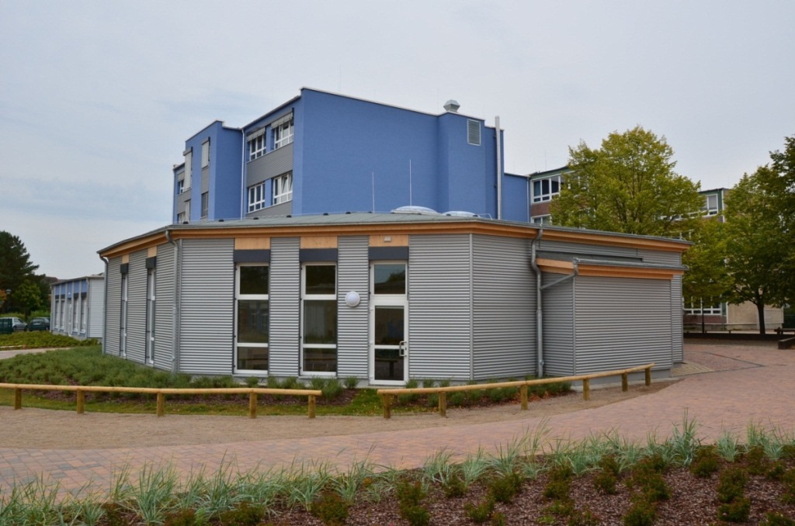
Our School

Slide 3
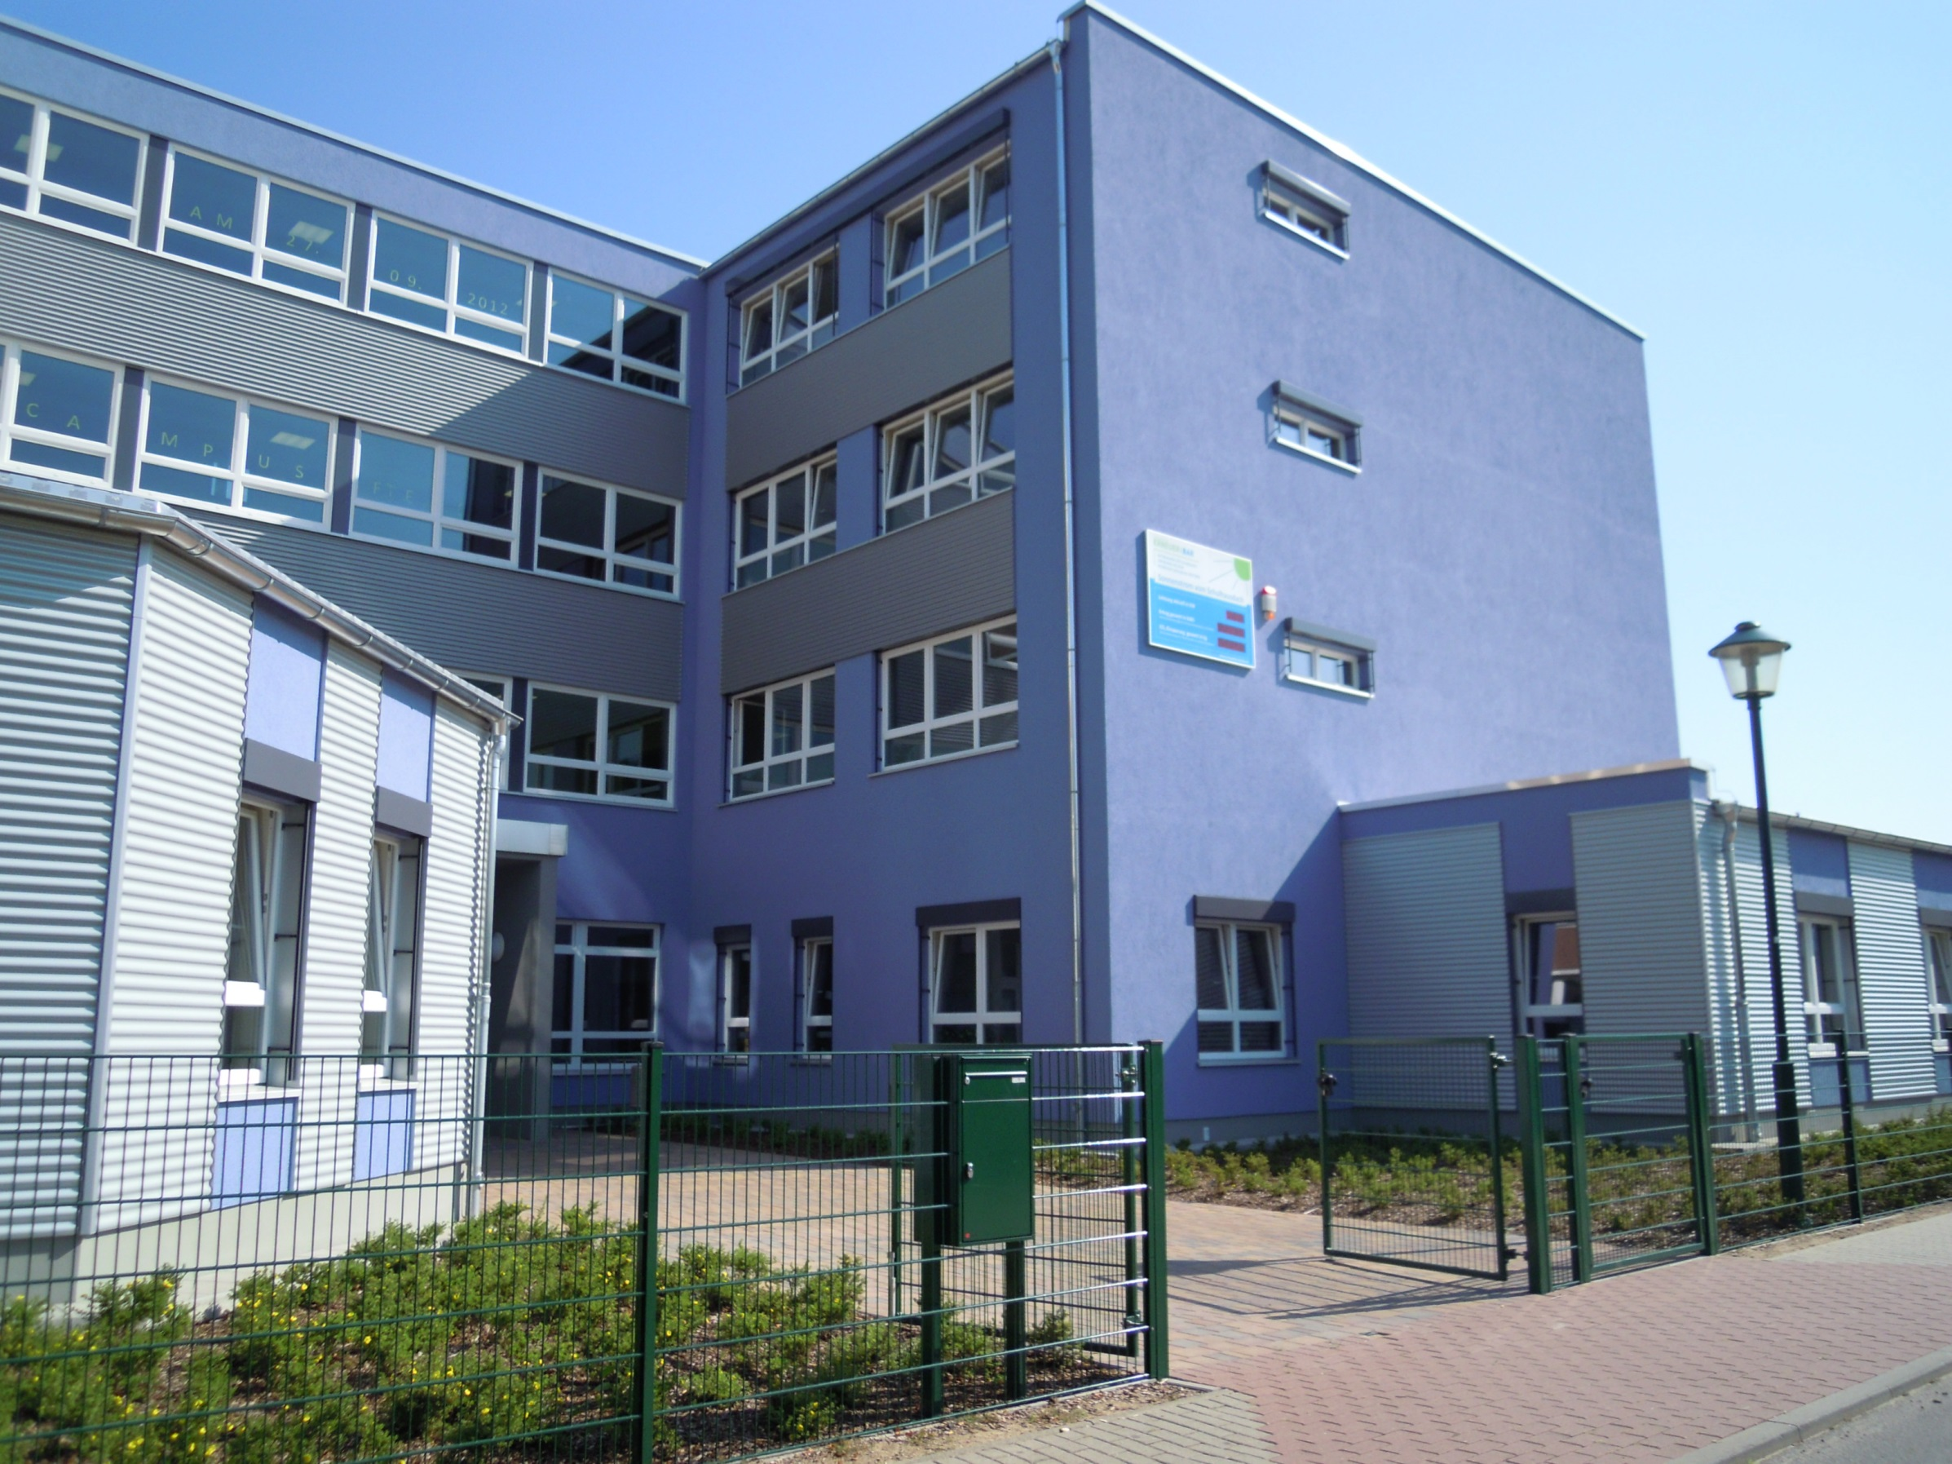

Slide 4
Contents
School building and rooms
Assembly hall
Grounds
Youth club
Schoolmanagement and teachers
School
Activities
Special Days

Slide 5
1. School building and rooms
Assembly hall
Gym
Computer rooms
Techniques and craft rooms
Class rooms
Cafeteria
Office
Homework room
Library

Slide 6
1.1. Timetable
lesson | time | minutes
open beginning | 7.30-8.00 | 30 min
1. lesson | 8.00-9.00 | 60 min
breakfest | 9.00-9.30 | 30 min
2. lesson | 9.30-10.30 | 60 min
break | 10.30-10.40 | 10 min
3. lesson | 10.40-11.40 | 60 min
lunch | 11.40-12.30 | 50 min
4. lesson | 12.30-13.30 | 60 min
break | 13.30-13.40 | 10 min
5. lesson | 13.40-14.40 | 60 min

Slide 7
2. Community room
Lunchbreak
A space for entertaining when the weather is bad
Lunch
Serves for entertainment purposes and school festivals
Serves to introduce of new classes

Slide 8
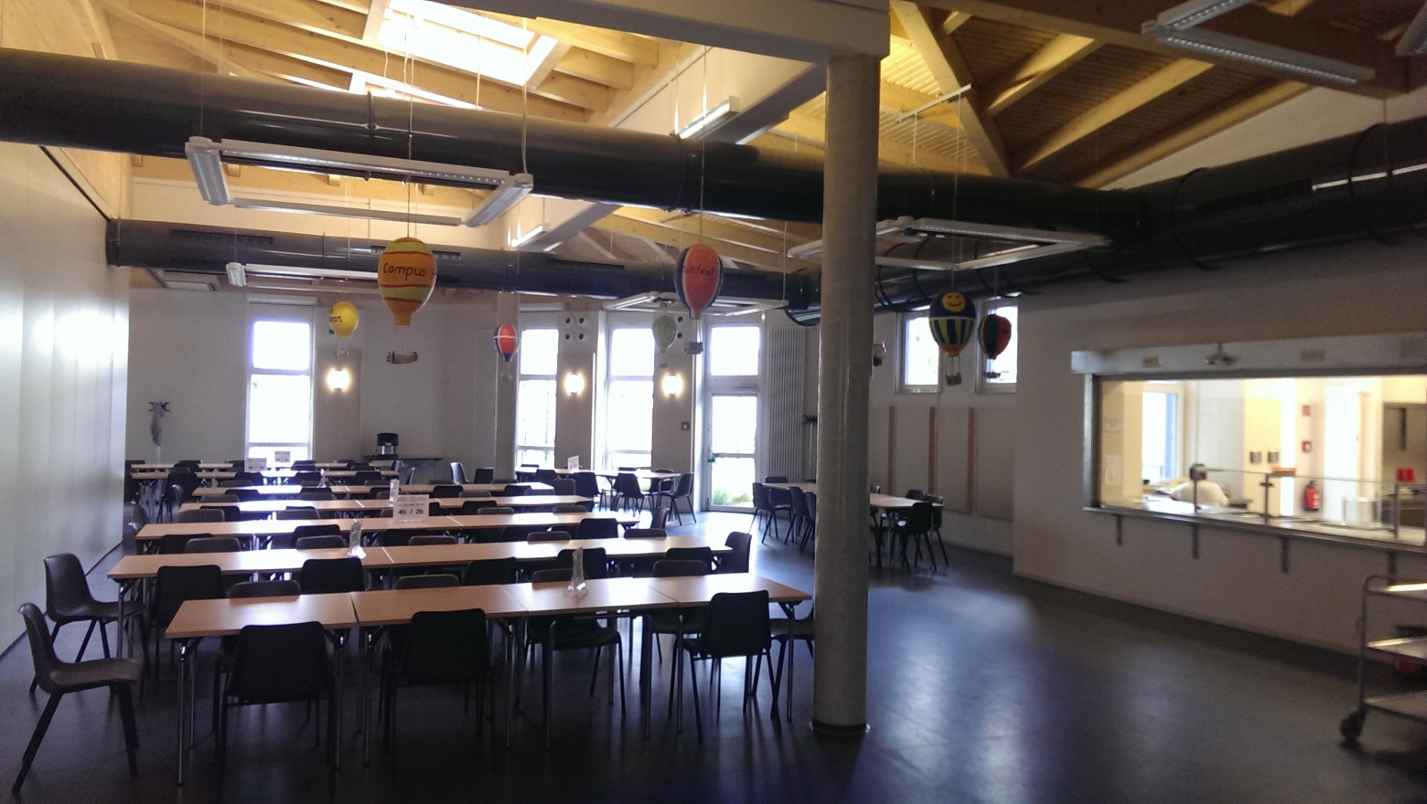
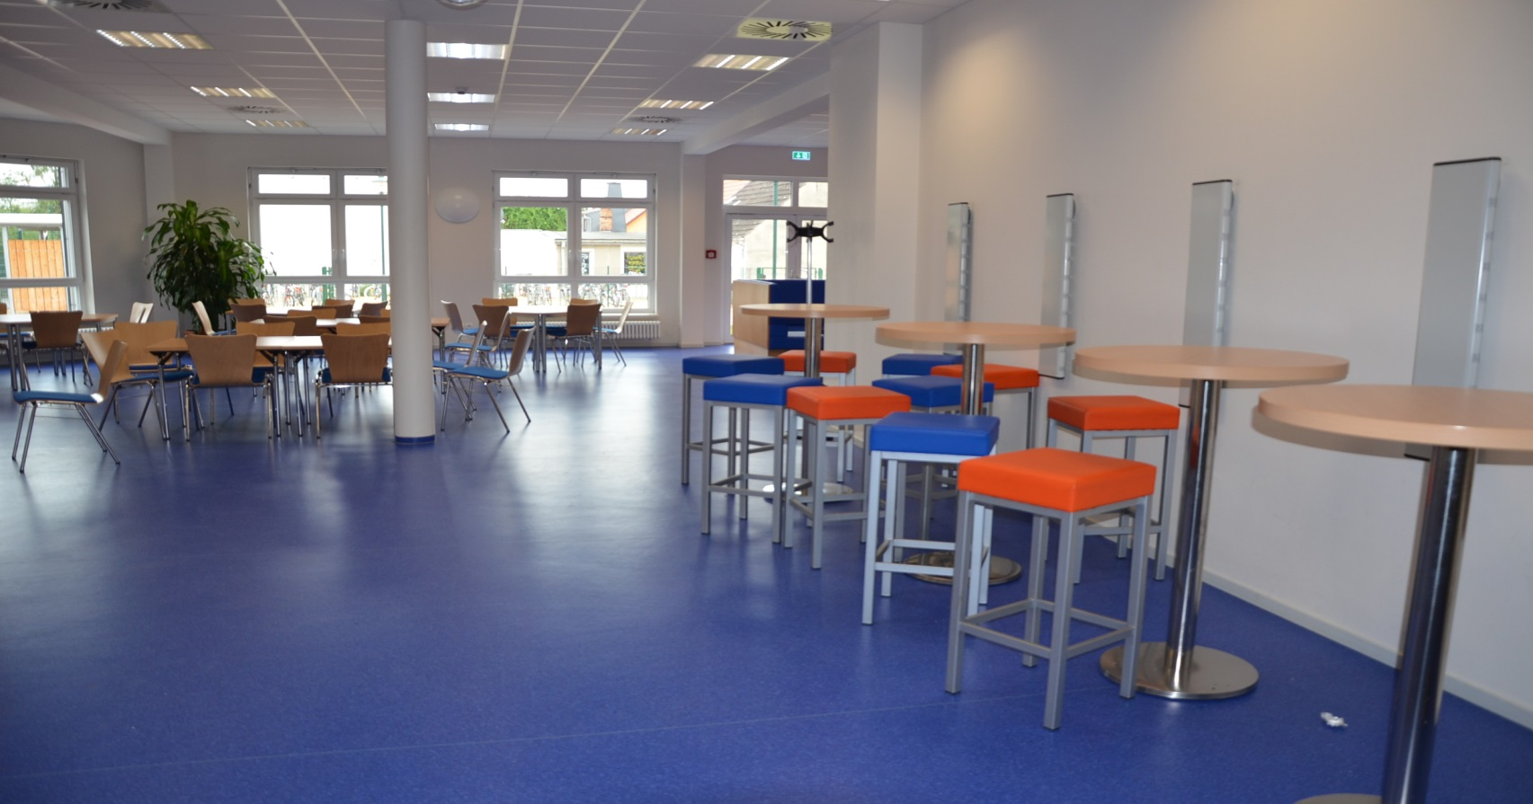
Room for different things
Cafeteria

Slide 9
3. Ground
Sports hall
Sports field
Schoolyard
Playground
Youth club
After school club
Primary school

Slide 10
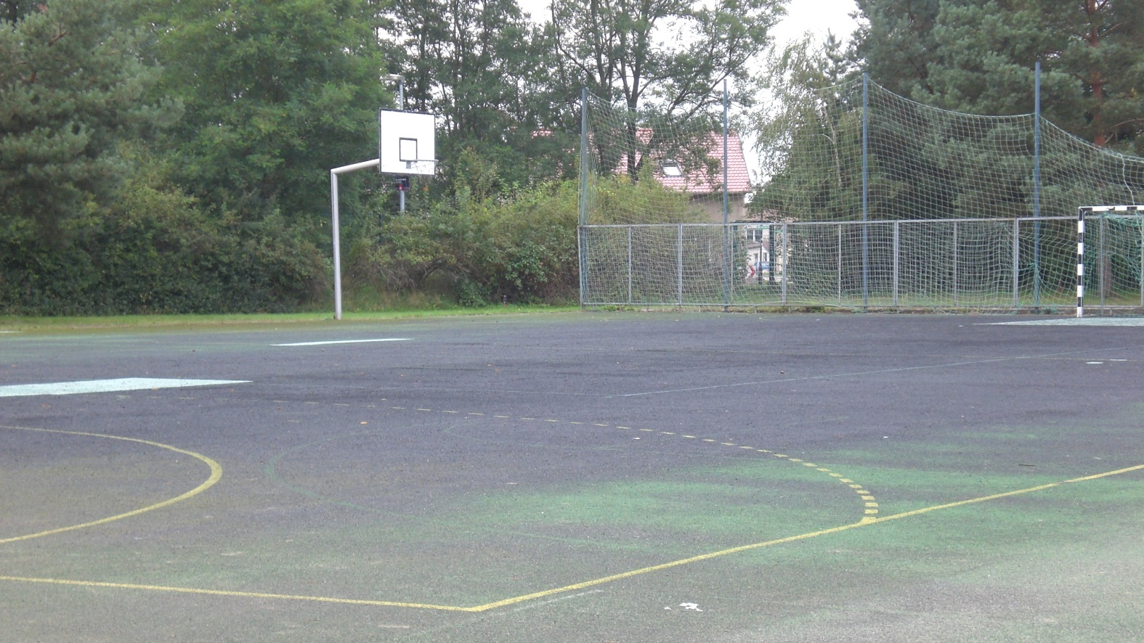
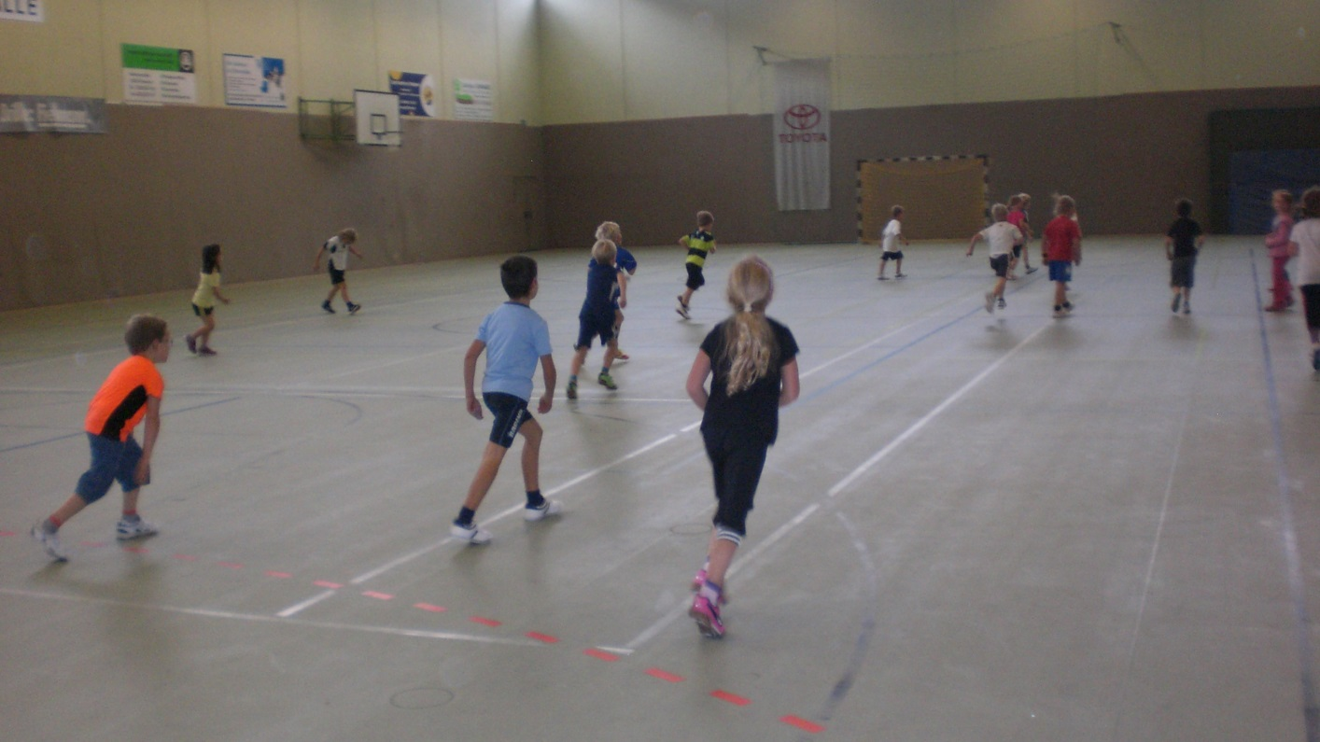
sports field and sports hall

Slide 11
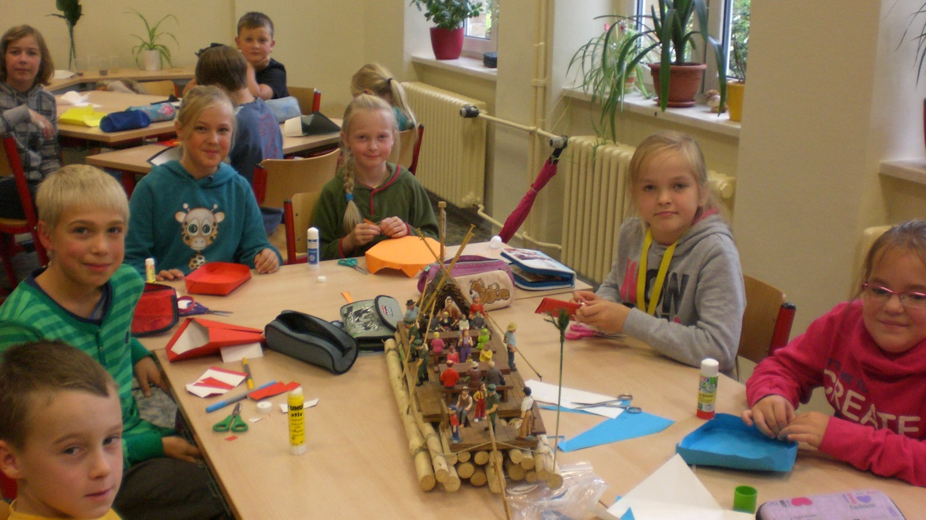
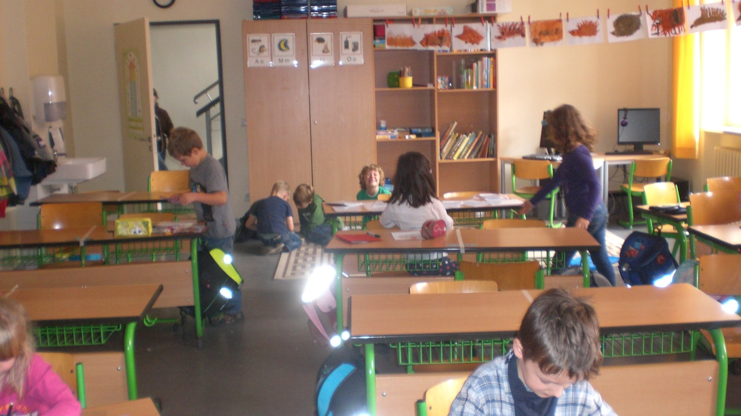
Primary school

Slide 12
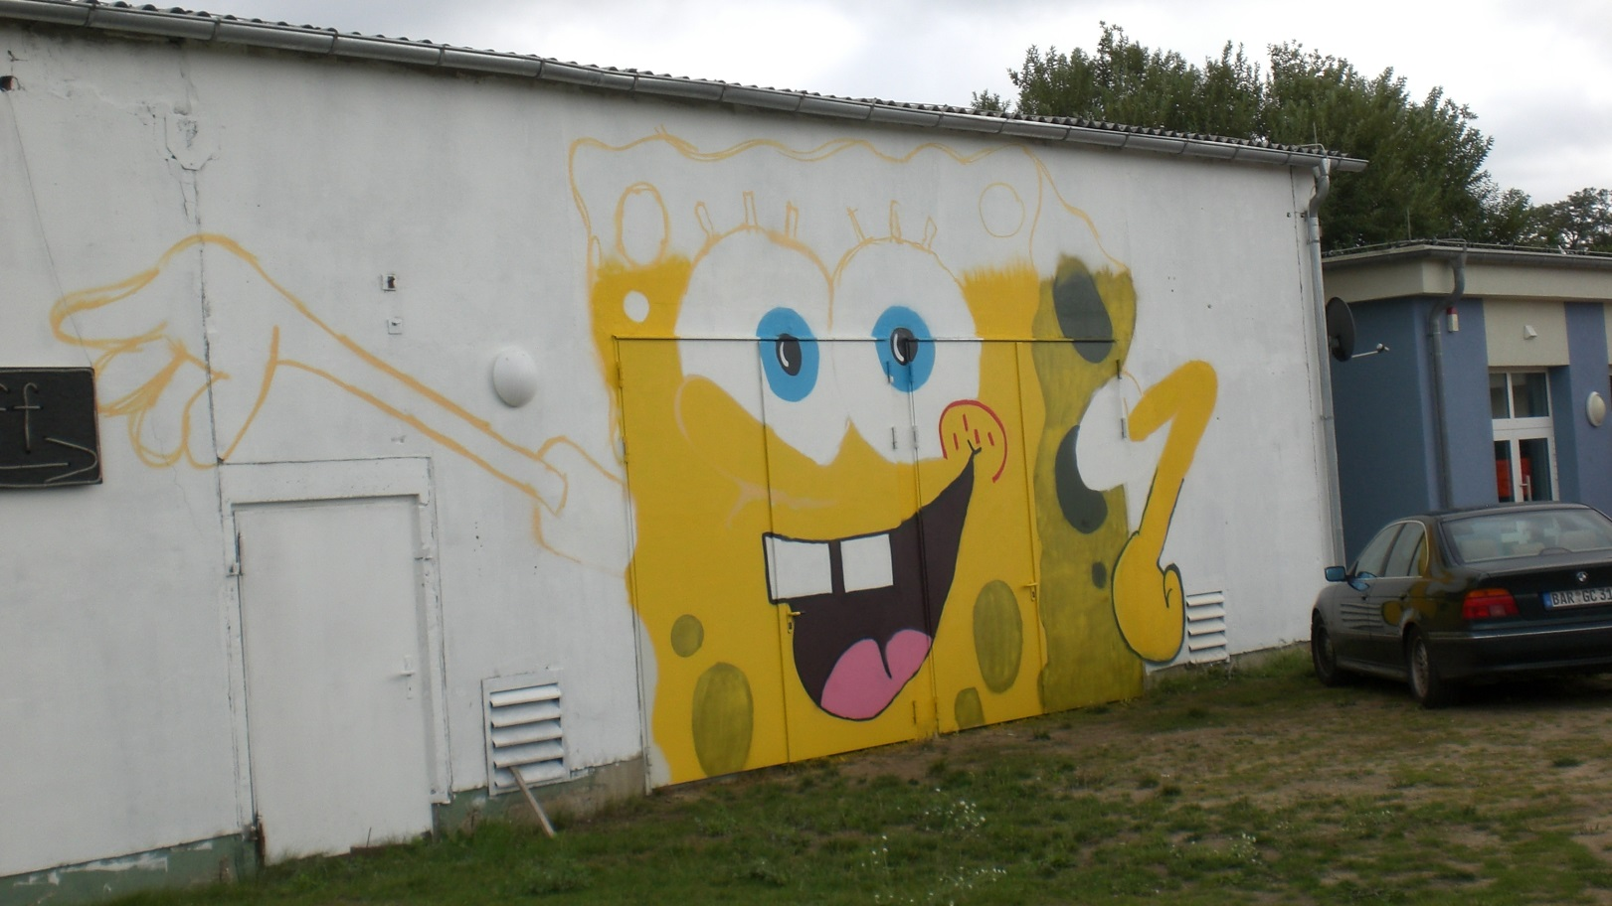
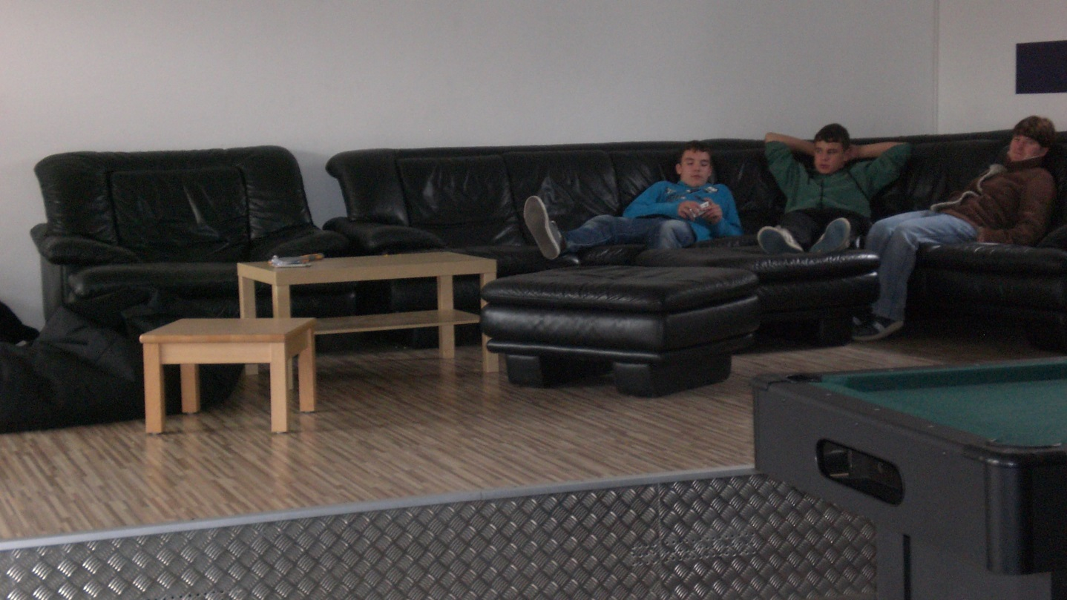
Youth club

Slide 13
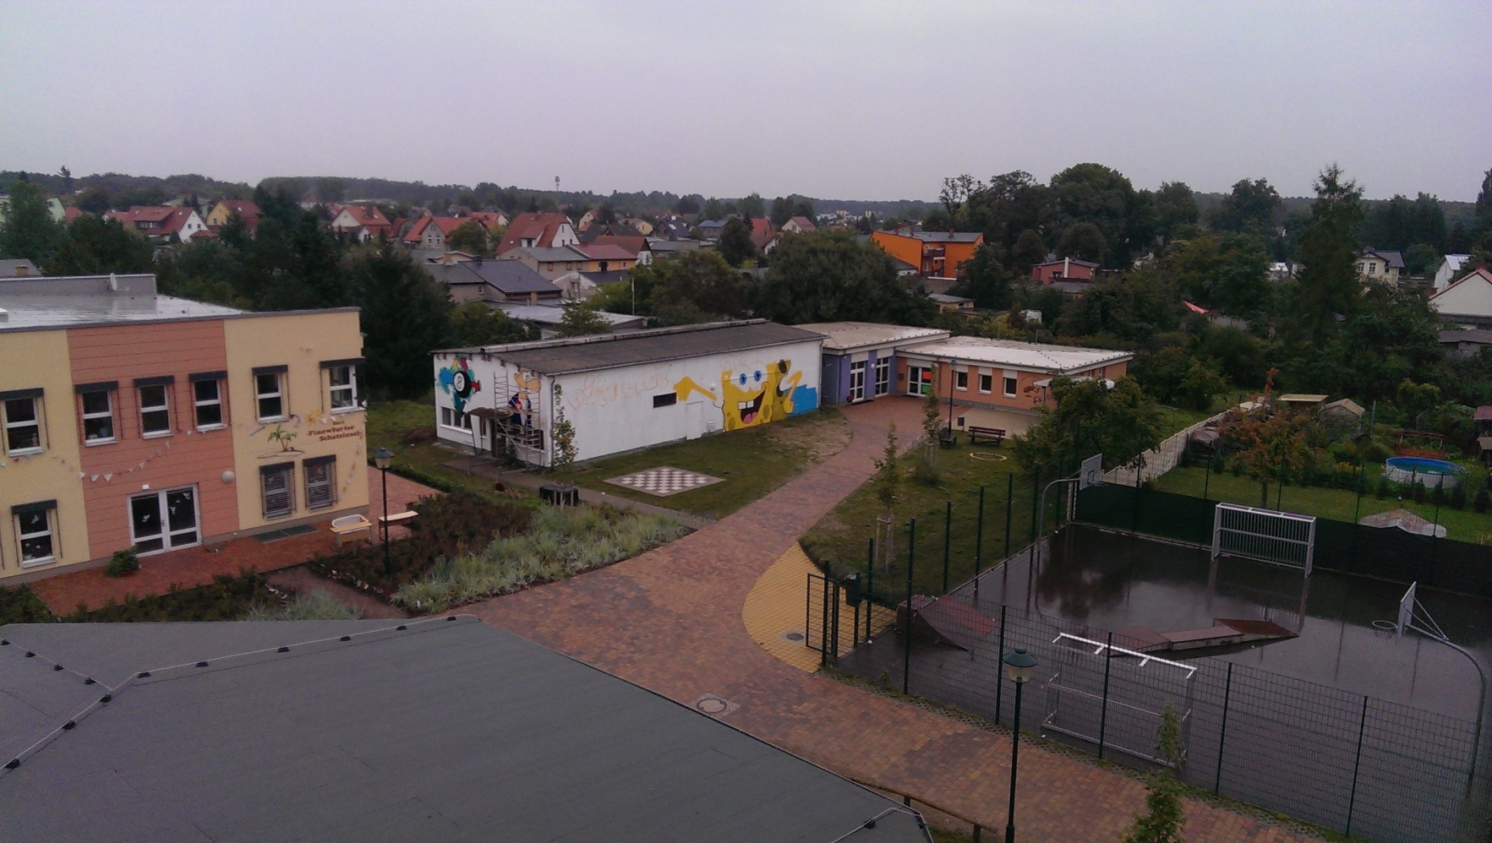
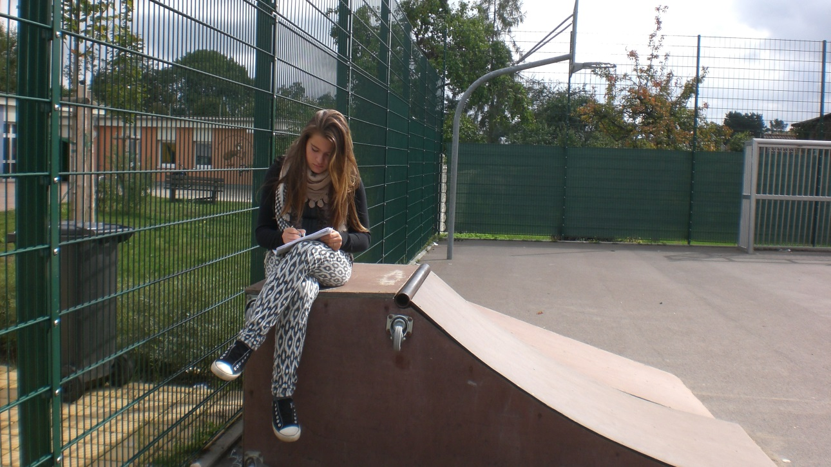
Youth club

Slide 14
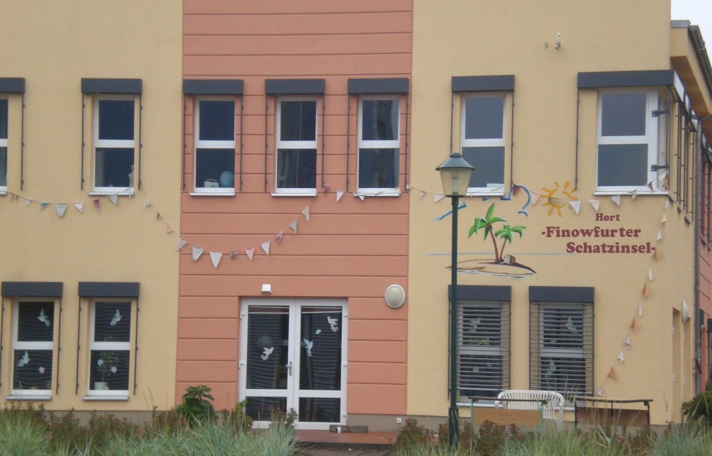
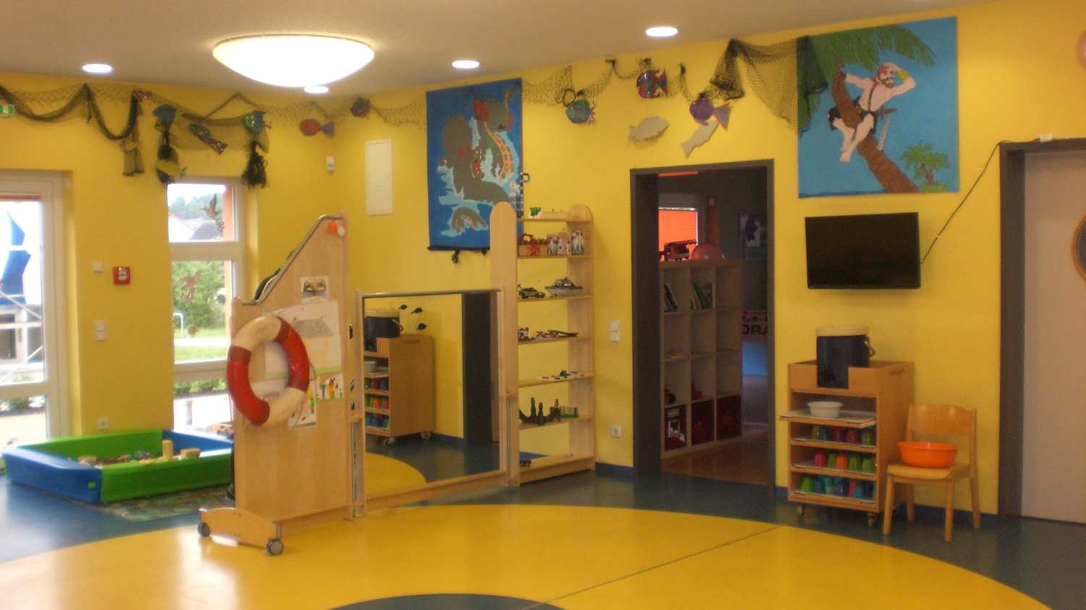
The young pupils do homework in the after school club. There, they have a lot of fun.
After school club

Slide 15
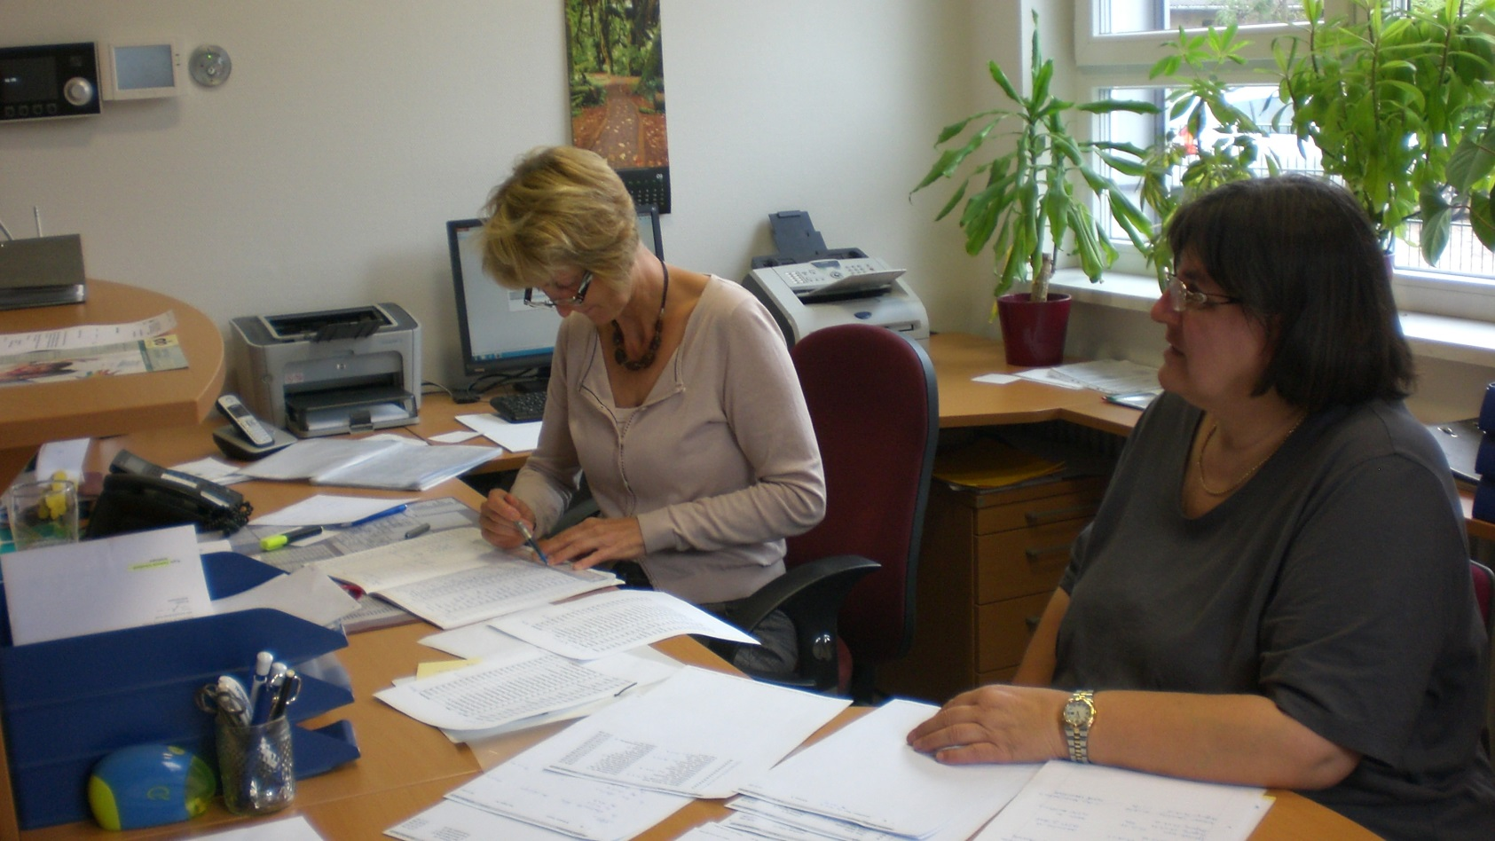
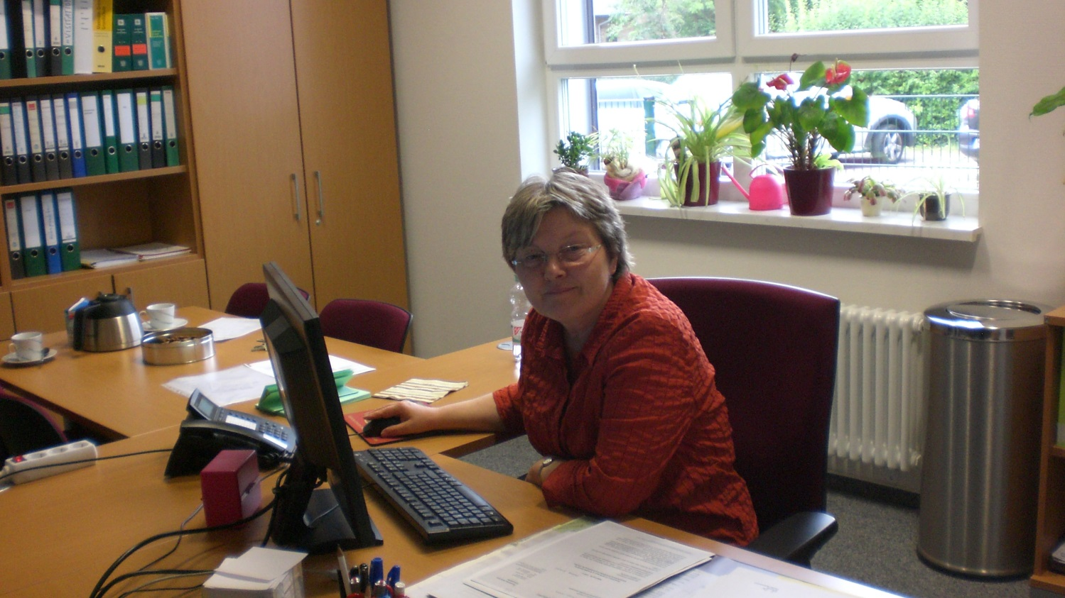
Office and the room of our headmistress

Slide 16
5. Schoolmanagement and teachers
Since 1996 Mrs. Kosanke is the headmistress of the school. Thanks to her support our school survived.
Mrs. Kupfer is the deputy headmistress of the school. She is managing the sequences of school. Once she was a pupil of this school. Since 1992 Mrs. Kupfer works as a teacher at the school Finowfurt.

Slide 17
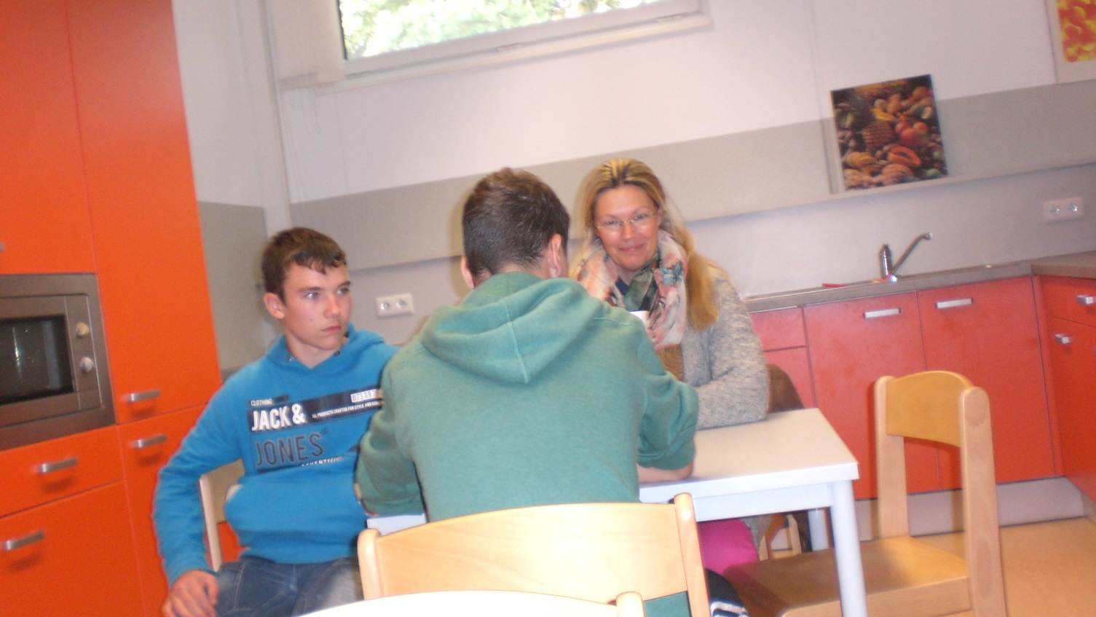
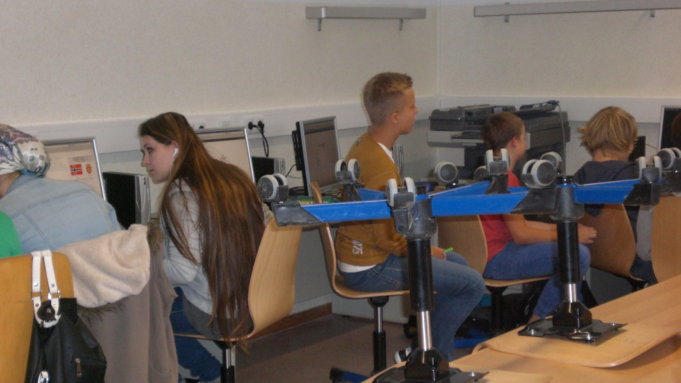
Kitchen and Computer-Room

Slide 18
4. Youth club
Club to chill
You can play there
There you can eat and drink baguettes, cola, ice and others
You can play pool billiards and table tennis
The teenage club chef´s name is Joschi Bauer
There you can have a lot of fun
Activities are cooking, baking, listening to music, meeting friends

Slide 19
6. School
The secondary school has 10 classes
The elementary school has 12 classes
430 pupils attend this school
37 teachers work here
Individual learning time (ILT)
  Time for homeworks, remedial classes, working and learning techniques

Slide 20
6. School
School leaving certificates
  FOR – training maturity
  EBR – extended training maturity
  FORQ – training maturity that allows to attend a grammar school
Abolition of the course-system
Learning in classes – we support each other

Slide 21
7. activities
Football tournaments
Clubs
Activities with Polish partner schools
Day of open doors
Snow-sports project
Polish-German youth meeting
School without racism – school with courage
Charity run
Project: „Responsibility“

Slide 22
7.1. Clubs
There are several clubs
There are 16 clubs, 5 of wich are chargeable
At the beginning of each school year there is a try out

Slide 23
7.2. Break activities
Youth club
Gym
Cafeteria
Computer room
Assembly hall + lunch + play ground
Library
Room for break

Slide 24
8. Special days
School festival
1st day at school
Christmas
Campus-festival
Childday
Ball befor the last 100 days of school

Slide 25
The End
The class 8b
of the Finowfurt school thanks for your attention

